Slide 1
Money Circulation Mechanisms: Micro-Meso-Macro
Svetlana Kirdina-Chandler
Institute of Economics, Russian Academy of Sciences,
Moscow, Russia

Slide 2
Motivation
Money is one of the most studied and at the same time the most mysterious phenomena of economic theory.
Orthodox micro- and macroeconomic approaches are not enough to open “the black box” of the real money economy especially in different institutional contexts.

Slide 3
Outline
Microeconomic approach
Macroeconomic approach
Heterodox traditions
Mesoeconomic heterodox approach
Introductory empirical studies
Conclusion

Slide 4
Money in microeconomics
Microeconomic approach

Slide 5
Money in Microeconomic equilibrium models
“The biggest challenge with analyzing money is that even the most sophisticated model of economics has no place for it. Such a model is, of course, a version of the Walrasian general equilibrium model proposed by Arrow and Debreu ”(Hahn 1983: 1).
“Money does not even appear in the analytical space of some of the most prestigious, mathematically sophisticated economic models, such as the Arrow-Debreu general equilibrium model” (Ingham 2004: 8).
”The difficulties which the mainstream analysis has in dealing with money and credit are well-known ... The mainstream approach has generally seen ‘money as a veil’ ” (Sawyer 2010: 296-297), without delving into the essence of the very process of money circulation.
So money in equilibrium microeconomic models is of no fundamental importance.

Slide 6
Money in macroeconomics
Macroeconomic approach

Slide 7
Does money feature in Macroeconomics?
Keynes J.M. proposed a more realistic approach to analysis of money circulation when he introduced ‘the transmission mechanism of monetary policy’.
However, the current understanding of the transmission mechanisms in mainstream macroeconomics is “masked” in an econometric model where money circulation mechanisms are not studied, but only the closeness of the correlations between changes in money supply and gross output (or total expenditure). Mainstream monetary economics regards the economy as a “black box” within which unknown processes take place (Moiseev 2002).
In the macroeconomic models of which are also based on microfoundations (Lavoie 2009; Aboobaker, Köhler, Prante, Tarne 2016) namely DSGE models, money continues to be considered mainly from the point of view of money supply.

Slide 8
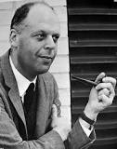
Why not Macroeconomics?
The macroeconomic approach is really not applicable to the analysis of complex structures. “Macroeconomic models are non-historical and do not contain anything that would distinguish market economies from Soviet-type economies or from the economies of Ancient Rome and medieval China” (Baumol 2001: 84).
William Baumol,
1992-2017

Slide 9
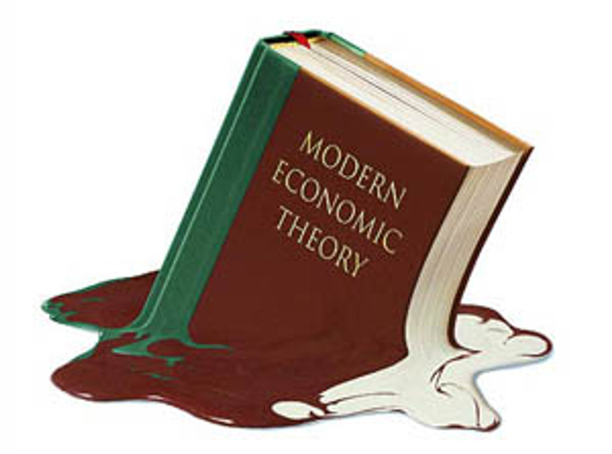
Money in modern economic theory
In Microeconomics money is just ‘a veil’ on economic relations between economic agents.
In Macroeconomics monetary and financial theories, as a rule, consider macroeconomic aggregates (money and GDP) and do not investigate the role of money in the process of the whole economic and social reproduction.

Slide 10
Classical figures and money
Heterodox traditions

Slide 11
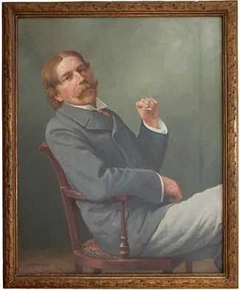
Thorstein B. Veblen (1857-1929)
The investigation of the dynamic economic process as a "cumulative or unfolding sequence” (Veblen 1898, 386);
The role of endogenous money creation (the credit economy), which is a significant factor in the unevenness and cyclical nature of the economic process (Veblen 1958);
Money as the most important economic institution.
https://www.google.com/search?q=Veblen&source=lnms&tbm=isch&sa=X&ved=2ahUKEwj119OG5vXtAhXIMMAKHQfKDcUQ_AUoAXoECBEQAw&biw=1280&bih=610#imgrc=FCM-uXfFqc71kM

Slide 12
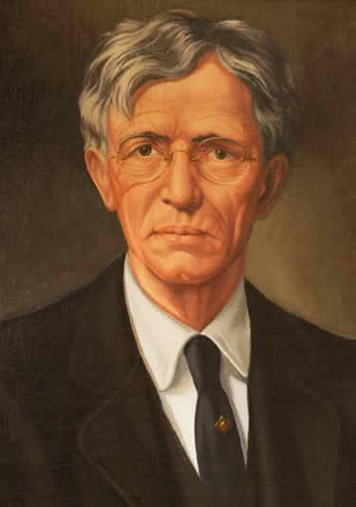
John R. Commons (1862-1945)
The Institutional Theory of Money;
The credit nature of money;
Money as a social institution: money is “a collective instrument for the creation, negotiability, and release of debt by individuals” (Commons 1934, 278);
The historical diversity of instruments and rules that have evolved in different societies to carry out its main functions with money (Commons 1934, 461).
https://www.google.com/search?q=John+R.+Commons+&tbm=isch&ved=2ahUKEwiZpcLC5vXtAhUSShoKHSVgDr0Q2-cCegQIABAA&oq=John+R.+Commons+&gs_lcp=CgNpbWcQAzIECAAQHjIGCAAQBRAeOgYIABAIEB5QtyFYz-kBYO3vAWgAcAB4AIABVYgB

Slide 13
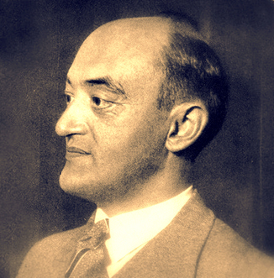
Joseph A. Schumpeter (1883-1950)
Economic evolution as a process of constant change and renewal;
Economic processes as the ‘development case’ with “abnormal credit”: money is not just ‘an entrance ticket’ to the economic world or ‘technical device’ to carry business transactions (Schumpeter 1917-1918);
His “monetary analysis” replaced the orthodox view of a “real” economy by the central concept of money as a “social accounting” system of economy (Lakomski-Laguerre 2016);
“Monetary infrastructure" is represented by different types of money, e.g. "routine" and "innovative“.
https://www.google.com/search?q=Joseph+A+Schumpeter&source=lnms&tbm=isch&sa=X&ved=2ahUKEwjKgrn_5vXtAhWIXsAKHQKICXQQ_AUoAXoECBEQAw&biw=1280&bih=610#imgrc=SI6CUhOvN73vzM

Slide 14
Money in heterodox mesoeconomics
Mesoeconomic heterodox approach

Slide 15
Modern heterodox Mesoeconomics
Mesoeconomics as a research area primarily integrates evolutionary and institutional concepts in economic theory (Potts 2007; Dopfer & Potts 2007);
Mesoeconomics is based on a certain set of initial prerequisites and has its own intra-disciplinary structure (Kirdina-Chandler, Maevsky 2020).

Slide 16
Mesoeconomics’ prerequisites continue evolutionary and institutional traditions -1
Economy is a complex system (systemic view) in which mesoeconomic structures arise due to the emergent effects of economic co-evolution processes and are qualitatively different from the microlevel (Elsner 2007), therefore mesofoundations not microfoundtioins are used;
The recognition of positive feedbacks - not only competition coordinating economic processes, but also other spontaneously emerging mechanisms like cooperation, redistribution, mergers and acquisitions etc. (Dementiev 2002; 2015; Mesoeconomics of Development ... 2011, 21)..

Slide 17
Mesoeconomics’ prerequisites continue evolutionary and institutional traditions -2
Economy is considered as a dynamically developing system, in which processes are important rather than static states (or changing static states);
The social conditioning of economic mesostructures; an "institutional view" and an understanding of the social embeddedness (Polanyi, 1944) of economic processes.

Slide 18
Money Circulation Mechanisms
are the interconnected sets of processes and instruments used by institutional agents within the social and economic national system. Money circulation mechanisms represent the kind of functional mesoeconomic structure which provides the economic reproduction and development.

Slide 19
mesoeconomic approach to money analysis
Introductory empirical studies

Slide 20
Ingham, G. 2004. The Nature of Money. Cambridge, UK: Polity Press.
Building on Schumpeter’s ideas, he examines money in a developmental context: “With its emphasis on the development of capitalism, The Nature of Money helps to position findings from mesolevel studies of institutional development in economic sociology within the broader economic and political context of a theory of capitalism” (Beckert 2006, 1299).

Slide 21
Kirdina, S., Vernikov, A. 2013. Evolution of the Banking System in the Russian Context: An Institutional View. JEI 47(2): 475-484.
A different role of banking for countries where X-matrix institutions (Kirdina, 2014; Kirdina-Chandler 2017) are predominant (like Russia and China) compared to countries where Y-matrix institutions are predominant (like economies of central Europe) is shown. These differences reflect different institutional dynamics inherent to two fundamentally different types of societies.

Slide 22
Maevsky, V.,Malkov, S.,Rubinstein,A. 2019. Analysis of the Relationship between Issuing Money, Inflation and Economic Growth… Voprosy Ekonomiki 8: 45-66. (In Russ.).
Calculations based on the mesoeconomic model allowed them to obtain non-trivial theoretical results contributing to the discussion on the neutrality/non-neutrality of money.
It is shown that the phenomenon of money neutrality in the long run is not a general rule, as it is in the orthodox economic model, but just a special case.
On the contrary, the general rule can be considered as the phenomenon of non-neutrality of money in the long run.

Slide 23
Conclusion and discussion
There is still work to be done in the research of money and money circulation, but perspectives for such work are different for orthodox and heterodox economic theory especially for heterodox mesoeconomics.
Some results based on the mesoeconomic approach are very promising:
- a deeper understanding of the nature of money;
- identification of the specifics of the monetary infrastructure in various institutional contexts;
- the reliance on mesofoundations allows consideration of endogenous money circulation in the context of capital reproduction processes and to identify the conditions of neutrality / non-neutrality of money in the short and long term.
The main challenges for ongoing mesoeconomic research of money and money circulation are connected with overcoming its fragmentation and providing deeper methodological reflection.

Slide 24
Thank you for your attention!
Svetlana KIRDINA-CHANDLER
kirdina777@gmail.com
kirdina@bk.ru
www.kirdina.ru

