Slide 1
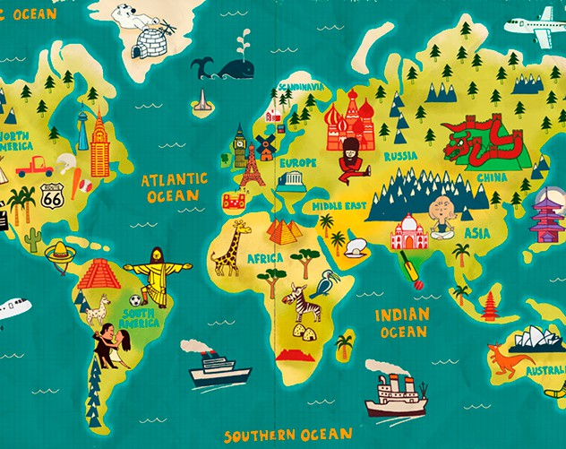
WESTERN AND NON-WESTERN INSTITUTIONAL MODELS IN TIME AND GEOGRAPHICAL SPACE
Svetlana Kirdina-Chandler,
Institute of Economics, Russian Academy of Sciences, Moscow, Russia

Slide 2
Motivation
Change in the configuration of the global political and economic structure is becoming increasingly evident:
- new economic giants in the East, primarily China and India, as well as the
growth of Russia's political role
- growing social and economic inequality in the majority of developed
economies.
These two factors contest the leadership of the Western institutional model of economic development: this model not only does not have a universal character, but it also does not show as many manifest advantages as has been thought previously.
Under these conditions, understanding the institutional features of both poles of the returning bipolar world (Western and non-Western) becomes needful.

Slide 3
Outline
Some approaches to the study of economic and political systems, generalised in terms of "Western and non-Western institutional models."
Two models within the framework of the Theory of X and Y Institutional Matrices.
The influence of geographic factors on the formation of these models.
The chronology of the coexistence of these two types of models.
Conclusion.

Slide 4
Some approaches to the study of two types of economic and political systems, generalised in terms of "Western and non-Western institutional models."

Slide 5
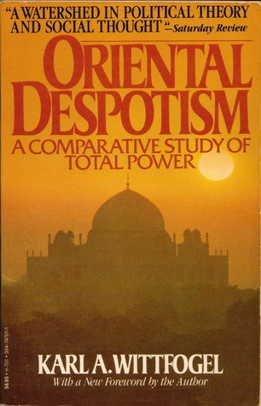
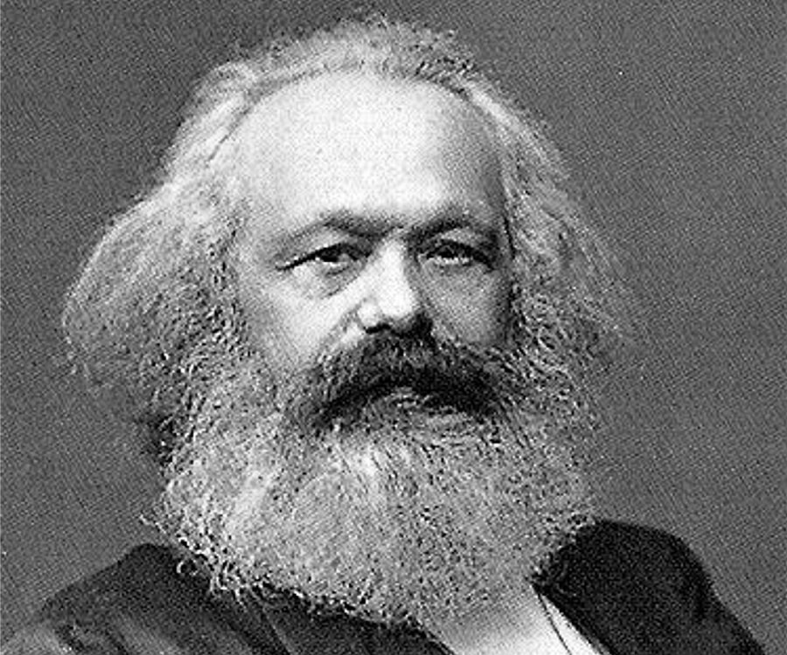
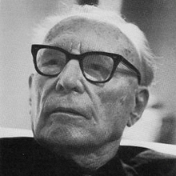
European versus Asiatic
Karl Marx,
the New-York Daily Tribune, 1853, 10 June
“The British Rule in India”.
1957

Slide 6
European versus Asiatic cont.
Karl Marx (1818-1883): the difference of property institutions, characteristic of the "Asiatic mode of production", from the European one. No private property land in the European sense but the so called "connecting unity“, or Zusammenfassende Einheit in Germ (Marx, 1939, p. 376-377).
Karl Wittfogel (1896-1988): the concept of “hydraulic civilisations”. The interrelationships of the economic structures of eastern countries with centralised political structures (Wittfogel, 1959).

Slide 7

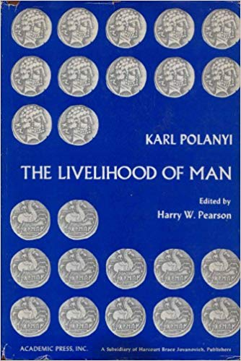
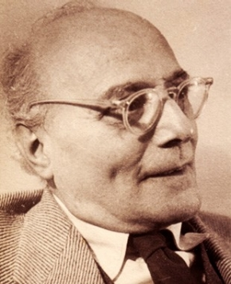
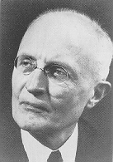
Economic Institutional Orders
1939 1939
1977

Slide 8
Economic Institutional Orders cont.
Walter Eucken (1891-1950): all economies can be understood as varied compositions of two basic principles: the decentralised co-ordination of economic activities within a framework of general rules and the principle of subordination within a centralised, administrative system. The dominance of one of these two models in economic life.
Karl Polanyi (1886-1964) : existence of two equivalent, parallel-functioning market (exchange) and redistributive (centralised) institutional complexes. One form of economic relations dominates, while the other takes a complementary position.

Slide 9
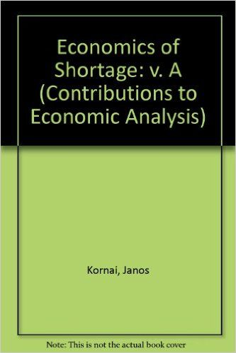

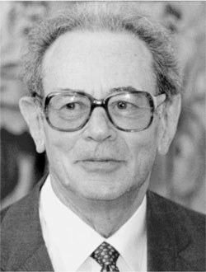

Political Economy of Socialism
1980
Soviet Political Economy of Socialism

Slide 10
Political Economy of Socialism cont.
The political economy of socialism (~1930-1991): capitalistic and socialistic societies
Janos Kornai (1928- ): “soft” (under socialism) or “hard” (under capitalism) budget constraints ( Resource-Constrained versus Demand-Constrained Systems // Econometrica. July 1979. № 47, 4).

Slide 11
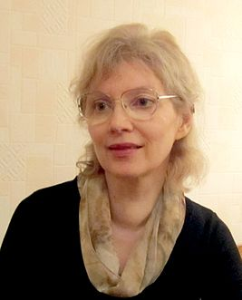
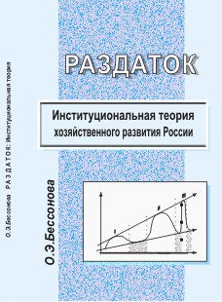
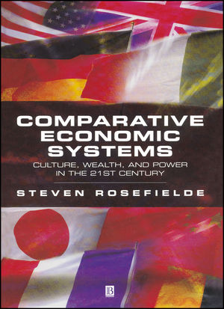

Modern Concepts beyond Mainstream
Bessonova Olga (1958- ): market and razdatok-economies
Steven Rosefielde (1942- ): market self-regulating category A economies and culture-regulated category B economies

Slide 12
Common features
Most of these authors consider two types of economic models as simultaneously existing in different countries.

Slide 13


Concepts in Economic Mainstream
The theory of open access orders and limited access orders, 2009
The theory of inclusive and extractive institutions, 2012

Slide 14
Concepts in Economic Mainstream cont.
These theories are based on certain ideological guidelines, which allow authors to consolidate "scientifically established facts" into a single whole (Polterovich, 2017, p. 57; Arslanov, 2016; Diamond, 2012).
The value judgements are shown by the fact that these models – which include open access orders in the theory of North and his colleagues or societies with inclusive institutions as in Acemoglu and Robinson’s theory - characterise Western countries, and they are presented in the framework of these theories as more developed and advanced in an institutional sense.

Slide 15
Two models within the framework of the theory of x and y Institutional Matrices

Slide 16
IMT in Russia and beyond
The main ideas are presented in many books and articles (see: www.kirdina.ru in Russian and English)
The IMT is included in the “Sociological Encyclopedia”, 2003 and ”Sociological Dictionary”, 2010, 2012 (both in Russian).
The IMT is presented in curricula on Sociology, Economics & Political Science courses offered at main Russian universities (Russian Internet data).
References to the IMT and summary of the main IMT provisions (with a critique ) can be found e.g. in the Journal of Economic Issues, 2014-2018.
Notes:
I suppose the Institutional Matrices Theory is unknown for you. But 10 000 kilometers away from here some people have heard something about it – I mean my own country.
And main points of the Institutional matrices theory will be presented today here.

Slide 17
Main assumptions of IMT, or X- and Y-theory
Each sphere (economy, politics and ideology) is regulated or guided by a particular set of basic institutions made in the image of a society.
Economic, political and ideological institutions represent the “institutional matrix” of societies.
Two main types of institutional matrices can be identified: the X-matrix and the Y-matrix.
Notes:
You see the main theses of the theory here.
First, each sphere like economy, politics and ideology is regulated or guided by a corresponding set of basic institutions made-in-a-society’s image.
Second, economic, political and ideological institutions comprise the “institutional matrix” of human society.
Third, historical observations and empirical research as well as mathematical modelling and a broad philosophical approach provide a ground for our hypothesis that two particular types of institutional matrices can be identified. Namely, we call the two types X-matrices and Y-matrices and compare the unique identities of each one. An X-matrix and a Y-matrix differ by the sets of institutions forming them.

Slide 18
X- and Y-matrices
Redistributive economy
X
Y
Federative political order
Unitary-centralized political order
Individualistic ideology
Communitarian ideology
Market economy
* Redistributive economy with the Center * Market (exchange) economy
mediating the economic transactions
* Centralized political order (top-down model) * Federative political order (bottom-up model)
* Communitarian ideology (We over Me) * Individualistic ideology (I over We)
Notes:
So, the X-matrix is formed by the following basic institutions:
in the economic sphere these are redistributive economy institutions (Karl Polanyi has introduced this term). Redistribution means that the Center mediates the movement of goods and services, as well as the rights for their production and use;
in the political sphere they correspond to institutions of unitary-centralized political order;
in the ideological sphere the communitarian ideology dominates. It is expressed in the idea of priority of collective, public values over individual ones. We is over Me.
Different basic institutions are connected in the Y-matrix:
in the economic sphere these are institutions of market economy;
in the political sphere they correspond to institutions of federative political order;
Respectively, the ideology of subsidiarity dominates. What is the essence of subsidiarity idea? It proclaims the subsidiary, subordinated character of collective values to individual ones. In this case Me or I is over We.
You can see that X-matrix looks like pure WITT-society ("We're In This Together”) and Y-matrix looks like pure YOYO- society (“You’re On Your Own”).
There is a bunch or set of institutions in economic, political and ideological spheres for each matrix. We won’t consider these institutions in details due to shortage of time. Therefore I skip the next three slides.

Slide 19
Combinations of X- and Y-matrices
Y
Y
X
X
Russia, China, India, Europe and Western
most Asian, Middle Eastern, Offshoots: US,
Latin American as well as Canada, Australia,
some other countries and New Zealand
Notes:
Our hypothesis is that the institutional structure of each society can be presented as a combination of these two basic institutional matrices. In some societies the X-matrix institutions prevail, while Y-institutions help them. We assume that it is true for Russia, China, India and most Asian, Latin American, and some other countries.
At the same time in other societies the Y-matrix institutions predominates, whereas the X-matrix institutions are complementary and additional, as, for example, in most countries of Europe and western offshoots including the USA.
We suppose that the main task of social and economic policy in each country is to support the optimal combination of predominant and complementary institutions. For example, the economic policy has to find the best proportion between market and redistributive institutions as well as forms of their modernization.

Slide 20
The influence of geographic factors on the formation of both types of models.

Slide 21
Geography is important?
The debate about comparative roles of geographical and social (institutional) factors in economic development has been continuing for hundred years.
The fundamental basis of the debate is consideration of the economic world from the perspective of the interrelationship between nature and society ( Lorenz A, Hemmer H.-R., Ahlfeld S. 2005. «The Economic Growth Debate – Geography Versus Institutions: Is There Anything Really New?»)

Slide 22
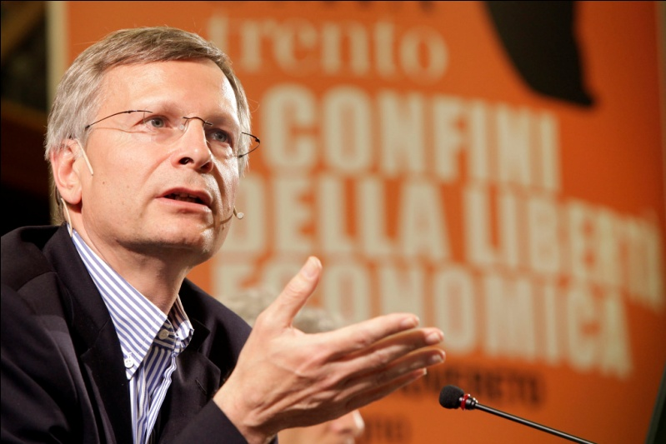
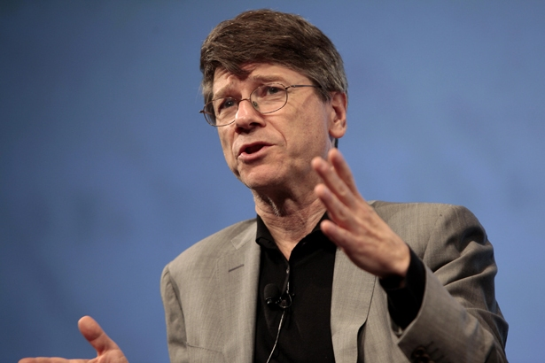
Geographical Hypothesis in Institutional Economics - discussion in National Bureau of Economic Research, US, 2000s
«Institutions Rule: The Primacy of Institutions over Geography
and Integration in Economic Development» (Rodrik at al., 2002)
«Institutions Don’t Rule: Direct Effects of Geography on Per Capita Income» (Sachs, 2003)
Notes:
Since the late 1990s. Cross-country comparative studies are conducted to identify the two main groups of issues. First, it compares the role of geography and the quality of institutions in achieving higher indicators of economic development. As a rule, we are talking about the rate of GDP growth or income level. Secondly, the influence of geographical features of different countries on the state and development of institutions that contribute to economic growth is investigated. In the field of consideration are usually such economic institutions as the protection of property rights, the effectiveness of the state, the nature of regulation, etc.
Many studies are conducted in the United States under the auspices of the National Bureau of Economic Research (NBER) - the largest research organization, from which many Nobel laureates with the "American residence permit" came out. Along with US scientists, experts from other regions, such as Africa and the Middle East, are actively involved in comparative research. As a result, since the early 2000s. In the world literature the discussion "geography versus institutions" has developed between those who consider geographical differences more significant - in comparison with institutional factors - the factors of differentiation of economic growth and those who consider them less important.

Slide 23
The Methodology Used by Rodrik and Sachs
First, national institutions and geographical characteristics are classified as fundamental deep (in Rodrik’s terminology) factors of economic growth.
Second, geography is undoubtedly an exogenous factor both to economic growth and institutions.
Third, geography and institutions are essential to explain long-term trends.
Fourth, a so called reductionist approach was used when only some institutions (not the institutional environment as a whole) were included in the analysis. They did not take into account the phenomenon of embeddedness of economic institutions (Polanyi, 1968; Granovetter, 1985).
Notes:
Embeddedness refers to the degree to which economic activity is constrained by non-economic institutions and means that they are rooted in the whole system of other non-economic institutiona first of all political and ideological ones

Slide 24










Notes:
It is our team working on empirical arguments of the IMT.

Slide 25
Methodology of Our Research
A much wider range of geographic variables (more than 150) was used.
The characteristics of the institutional environment were represented by the type of institutional matrix (X- or Y) which predominated in the countries investigated (n=65).
The calculations were not based on linear econometric models with several explanatory variables. We used statistical modeling with data mining procedures and an original method of classification that allowed us to catch the nonlinear character of the relationship between the investigated parameters.
Data bases used: www.worldbank.org; www.cia.gov; www.gapminder.org; http://faostat3.fao.org; http://www.indexmundi.com; http://en.wikipedia.org; http://unstats.un.org; http://www.world-nuclear.org; http://www.bp.com; http://minerals.usgs.gov.
Notes:
Поскольку в основе исследования лежит гипотеза о типах доминирующих в странах институциональных матриц, следует несколько подробнее о ней сказать. Поскольку вряд ли все присутствующие знакомыми с этими книгами – первое издание относится к 1999 году, третье вышло в 2014 г.

Slide 26
Our Main Results
Geographic parameters that differ significantly for countries with dominating X or Y matrices were defined:
- Air temperatures
- Precipitation average
- Consequences of natural hazards (droughts, floods, earthquake, extreme temperatures and the like)
Two groups of so called “relatively hot" and “relatively cold" X-countries, and a third group of Y-countries occupying a "middle position" between the first two groups, were singled out.

Slide 27
The Revealed Regularity
In countries with relatively soft climate characteristics (optimal air temperatures and precipitation) as well as lower natural hazards, the results showed that so called Y-matrix institutions historically prevail.
In countries with extreme conditions where air temperatures are relatively hot or cold, levels of precipitation are relatively high or low, and natural hazards are quite high, the results showed that so called X-matrix institutions historically predominate.

Slide 28



«Relatively cold»
Х-countries
Y-countries
«Relatively hot »
Х-countries
t°C
aver.
6.4
9.3
23.1
t°С
min
1.0
4.6
17.4

Slide 29

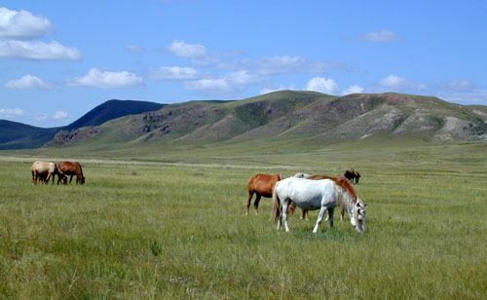


«Relatively cCold»
Х-countries
Y-countries
«Relatively hot»
Х-countries
Precipitation in year, мм
1100
760
1328
Amplitude of
Precipitation
(max-min),
мм
194
52
159

Slide 30
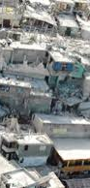
Population affected by natural hazards, %
«Relatively cold» Х-countries 1.9
Y-countries 0.1
«Relatively hot» Х-countries 1.3

Slide 31
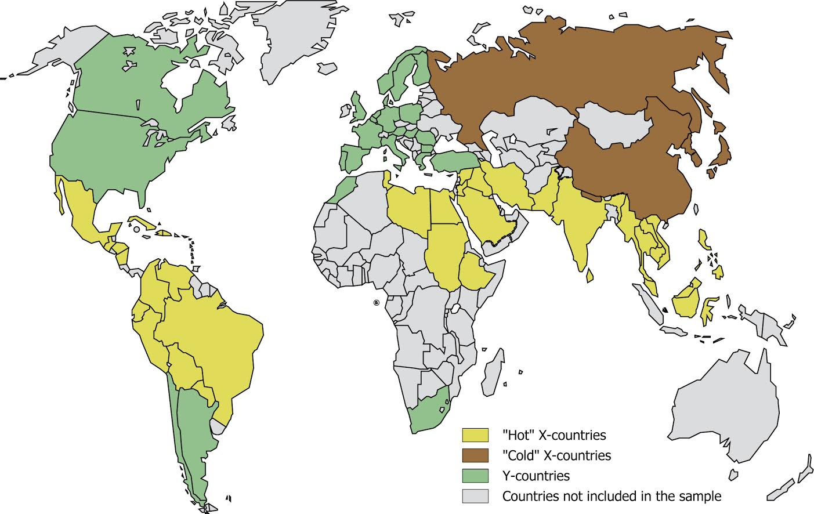

Countries - Mapping
Notes:
We can see that the Y-countries are located in a more moderate climatic zone.

Slide 32
Logical Justification
The history of any state begins with the stage of settled agricultural production, on which climate plays a determinant role. Societies can survive if they have learned to sustainably provide their population with food and protect it from environmental hazards. Primary basic institutions ("social technologies") are being formed.
“The social organisation of appropriation of the surrounding energy and power ... determines the institutional matrix" (Polanyi, 1977: xxxii).
In different climatic zones, agriculture developed in different ways. The examples of arid Egypt with centralised forms of farming, and fertile Mesopotamia with its initial forms of exchange coordination, are well-known proofs.
Notes:
The history of any state begins with the stage of settled agricultural production, and representatives of different sciences - from archeologists and historians to economists, culturologists, sociologists, etc. - converge in this. Societies can survive if they, above all, have learned to sustainably provide their population with food and protect it from the environment, regardless of the vagaries of nature. At the dawn of the first states, it is precisely in the agrarian sphere that certain social technologies (institutions) begin to take shape that organize the society for survival on a given territory, that is, The very adaptive mechanisms are formed, thanks to which it is possible to master the environment and use it to meet social needs. Carl Polanyi once again pointed out that "the social organization of appropriation of the surrounding energy and power ... determines the institutional matrix" (Polanyi, 1977: xxxii).
Obviously, the agrarian sphere is highly susceptible to the influence of climate. History shows that in different climatic zones, agriculture developed in different ways. Examples of arid Egypt with centralized forms of farming and fertile Mesopotamia with its initial market forms of coordination are well-known proofs. For more details, see Kirdina, 2001: 85-92; Kirdina, 2014: 89-98.
The transition from the agrarian to the industrial and the subsequent stages of social development did not abolish, but absorbed the institutional achievements of previous eras. The mechanisms of cumulative causality (T. Veblen), path dependence (P. David, P. Pierson, S. Leibovitz, S. Margolis, etc.), blocking effects (D. North), sociocultural evolution (J. And G. Lensky), etc., provided the transmission of social technologies and supported the dominant position of this or that institutional matrix, which arose at the dawn of the history of the state. Finally, the irreversibility of the "arrow of time" (A. Eddington) also does not allow to ignore the differences that have arisen in the previous stages of social development.
In this case, it is not so important, states are formed - as a result of slow progressive growth or as a result of intermittent evolution and non-linear development (for more details, see Abrutyn, Lawrence, 2010). It is important that this is unpredictable and irreversible.

Slide 33
Logical Justification cont.
The transition from the agrarian to the industrial and the subsequent stages of social development did not abolish, but absorbed the institutional achievements of previous eras. The mechanisms of cumulative causality (T. Veblen), path dependence (P. David, P. Pierson, S. Leibovitz, S. Margolis, etc.), block-in effects (D. North), socio-cultural evolution (J.E. and G. Lensky), “an ecological interpretation of history” (A. Leopold) and similar, provided the transmission of social technologies and supported the dominant position of a particular institutional matrix, which arose at the dawn of the history of the state.

Slide 34

The irreversibility (one-way direction) of Time’s Arrow by Arthur Eddington reflects the role of differences that have arisen in the previous stages of social development
Notes:
Никто не отменял необратимость «стрелы времени».

Slide 35
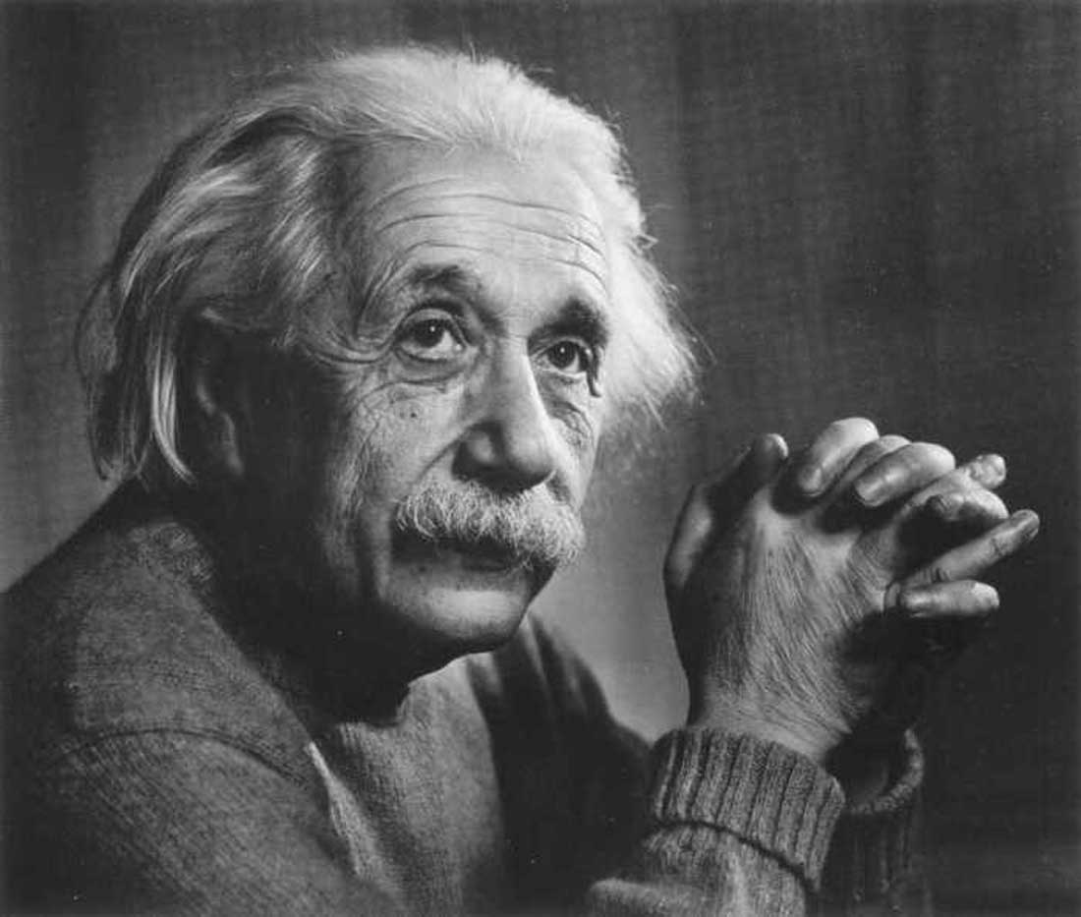
Is it too strong a simplification or… ?
«…the simpler our picture of the external world and the more facts it embraces, the more strongly it reflects in our minds the harmony of the universe” (Einstein, Albert and Leopold Infeld. 1938. The Evolution of Physics. Cambridge: Cambridge University Press, p. 225).

Slide 36
The chronology of the coexistence of THE two types of models.

Slide 37
The Comparative Long-term Dynamics of GDP Produced by X- and Y-countries
The data of the well-known tables of Angus Maddison (Maddison Project Database, 2018).
1820 was adopted as the starting reference point beginning with which there are data on a wide range of countries , which makes it possible to create a fairly representative sample of them (n=21, the share in world GDP ~75-85%).

Slide 38
GDP of countries with non-Western (X-country) and Western (Y-country) institutional models, 1820-2016, %, 100% in total,
Maddison Project Database, 2018, international, in Geary-Khamis, 1990 dollars, n=21.

Slide 39
Test № 2
The verification of this conclusion was tested in a wider sample of countries (n = 63 , with the share of world GDP ~90%), using data from the World Bank for the period 1990-2017.
The basis for the sample was the results of countries identified with the dominance of X- and Y-matrices, presented in Kirdina, Kuznetsova, Sen'ko, 2015 (in Russian).

Slide 40
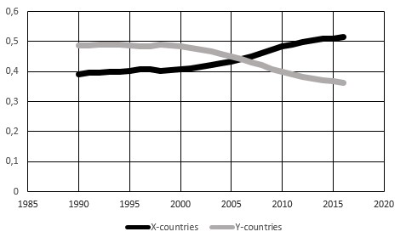
GDP of countries with non-Western (X-country) and Western (Y-country) institutional models, 1990-2017, as a % within the total world GDP, the World Bank database, n=63.

Slide 41
Conclusion
The results revealed the effect of climatic characteristics in the location of countries with different institutional models.
On territory with relatively mild climatic characteristics (optimal air temperatures and precipitation levels), as well as low natural hazard risks, countries with a dominance of Y-matrix institutions develop, i.e. they are characterised by Western institutional models.
In areas where there are significant fluctuations in the amplitudes of precipitation and air temperature, where average levels of temperatures and precipitation are relatively higher or lower, and the risks of natural hazards are quite high, X-matrix institutions, or Non-Western institutional models, historically predominate.

Slide 42
Conclusion cont.
Comparison of the GDP produced by the two groups of countries made it possible to see the cyclical process of changing world leadership, i.e. in the prevailing dominance of countries with Western or Non-Western institutional models.
In the 1820s, Non-Western countries were leading in the production of world GDP.
Since the 1870's the domination of Western countries started, which began to produce more than half of the world GDP. The biggest gap between these two groups of countries was observed in the 1950s-1960s. Since the 1970s it began to decline.
In 2005-2008 Non-Western countries began outperforming Western countries by share of world GDP, and this advantage continues to gradually increase.
Some of the consequences of such reconfiguration are analysed in the uploaded paper.

Slide 43
The Paper and Acknowledgements
Kirdina-Chandler, S. G. (2019). Western and non-Western economic institutional models in time and geographical space. Terra Economicus, 17(1), 8–23. DOI: 10.23683/2073-6606-2019-17-1-8-23 https://te.sfedu.ru/evjur/data/2019/1/kirdina-chendler.pdf
The research was supported by grants from the Russian Humanitarian Scientific Foundation (project # 14-02-00422) and the Russian Foundation for Basic Research (Project # 17-02-00207).

Slide 44
Thank you for your attention!
Svetlana Kirdina-Chandler
www.kirdina.ru

