Slide 1
Neoclassical and Heterodox Economics: main bricks in the methodological wall separating them
Svetlana Kirdina-Chandler
Institute of Economics, Russian Academy of Sciences,
Moscow, Russia

Slide 2
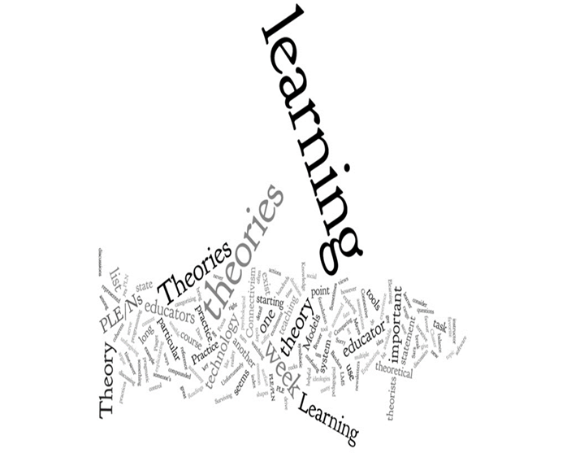
Motivation
The neoclassical mainstream has demonstrated its ability to absorb new theoretical approaches and ideas developed by non-neoclassical economists. In the course of the well-known “Neoclassical Synthesis” (Samuelson, 1967), the ideas of Keynes and other macroeconomists were incorporated into neoclassical economics.
The same takes place with the ideas of behavioural economics, institutionalism, etc.
“New Neoclassical Synthesis” (Woodford, 2009) adapted the ideas of monetary policy and began to develop DSGE-models (the effectiveness of which were disputed during the crisis of 2008-09:).
What are the prospects for heterodox economics? Will it be absorbed into orthodox economic theory and in the learning processes based on it?

Slide 3
Outline
The set of explicit and implicit premises on which neoclassical orthodox economists (NOE) and heterodox economists (HE) rely.
The differing interests and ideological engagement of the NOE and HE.
What are prospects for HE?
Conclusion.
Notes:
It motivated me to prepare the paper with the following structure:

Slide 4
Explicit and implicit premises in orthodox and heterodox economics

Slide 5
Homo economicus versus embeddedness
NOE: Homo Economicus is a model of an economic agent who uses rational assessments, attempts to maximise utility as a consumer and economic profit as a producer.
Other features of economic agents are not so important.
HE: Embeddedness refers to the degree to which economic activity is constrained by non-economic institutions.
“Actors do not behave or decide as atoms outside a social context… . Their attempts at purposive action are instead embedded in concrete, ongoing systems of social relations.” (Granovetter 1985:487).

Slide 6
Linear approach versus complexity
(diminishing returns versus increasing returns)
NOE: the economy is considered as the formation of an equilibrium of supply and demand, when price signals act as gravitational forces.
This balance is achieved due to the fact that the hypothesis of predominantly diminishing returns of factors of production is accepted.
The hypothesis of diminishing returns of factors of production is the basis of almost all mathematical models used.
HE: Not only ​​equilibrium but the nonequilibrium of economic processes take place.
Not only diminishing but also increasing returns are equally included in the descriptive model of the economic system.
The attention to increasing returns, the cause of which are positive feedbacks in the economy, is taken into account. Such effects are observed in complex systems capable of self-organistion.

Slide 7

Methodological individualism versus methodological holism (methodological institutionalism as well)-1
NOE: Methodological individualism "assumes an explanation of social and economic phenomena in terms of individual behavior" (Lukes, 1973: Hodgson, 2003, 2007).
What is the focus of institutional studies from this point of view? It is to understand what rules governing the interactions of people will at the same time help facilitate the achievement of their personal goals and make everyone aware of how their actions affect other people.
The institutional environment, therefore, is considered from the point of view of regulation of the interests of economic agents.

Slide 8

Methodological individualism versus methodological holism (methodological institutionalism as well)-2
HE: Methodological holism (Gruchy, 1947 ; Rutherford, 1989) and methodological institutionalism (Keizer, 2007; Kirdina, 2013) assume an explanation of the phenomena in terms of their role in the organisation of the entire economy as a system.
What is the focus of institutional studies from this point of view? It is to understand to what extent institutional design of economic relations allows the entire economy to develop and provide the proportions necessary for its expanded reproduction under spatial, temporal, technological, global-political and cultural conditions of the economy.
The institutional environment, therefore, is considered primarily as a tool for the self-organisation (made by people) of the economic system.

Slide 9



Economy from the Methodological institutionalism point of view
Economy from the Methodological individualism point of view
Agents
Institutions
Agents
Institutions

Slide 10
Microfoundations versus the micro-meso-macro framework
NOE: Among the microfoundations are the prerequisites of the rationality of economic agents, competition, profit maximisation and the equilibrium principle.
- agents at micro level are individual actors;
- agents at macro level are aggregates at the level of national or global economies;
- agents of meso level are large corporations, industries or regional economic complexes.
Robert Skidelsky after Keynes (1903) argues that the idea of microfoundations is the ‘worm’ standing in the way of progress in economics. http://www.primeeconomics.org/articles/macroeconomics-and-microfoundations-3
HE: The recognition of the hierarchical nature of the economy, because it is the effect of the self-organisation of any sufficiently complex system (Chernavsky, Kurdyumov, 2010: 97).
Development is understood as an irreversible process of evolution with successive changes in the hierarchy of structures and mechanisms of increasing complexity (“the Other Canon”). Usually changes “take place in between the micro and macro, so we can rightly call them meso-phenomena” (Arthur, 2013).

Slide 11


Market versus not only market
Unlike NOE, HE implies that not only market interactions,
but also other, for example, redistributive
types (Zezza, Llambí, 2002, Dementiev, 2018) develop in economies and can be dominant.

Slide 12
HE versus NOE
HE view “gives us a world closer to that of political economy than neoclassical theory, a world that is organic, evolutionary, and historically contingent” (Arthur, 2013).
Summing up, we can see that ideas of heterodox economics restore the traditions of classical political economy, exploring the logic of the formation of economic mechanisms that create patterns of economic life and the spread of change.

Slide 13
Formalisation trap
The adoption of NOE prerequisites is a consequence of an orientation toward the general principles of building economic knowledge in mathematised natural science. Leon Walras (1834-1910) attributed pure political economy to the physical and mathematical sciences.
In this case, the repeatability of empirical experiments and formalisation (the use of mathematics) are necessary.
Both of these approaches inevitably require using the reductionist approach and the simplification of research models.
The question is to what extent these models represent the economic performance of the modern world.

Slide 14
The differing interests and ideologies behind NOE and HE

Slide 15

Market and inequality versus broad perspective and justice
NOE are based on ideas of a progressive market, competition and the inevitable inequality generated by the market (Wei, 2019). We can call neoclassical economists “Wall street economists” or “typical Western economists”.
HE look more carefully at other forms of coordination including cooperation (Elsner, 2010) and justice in income distribution.
Different attitudes of NOE and HE are evident in their political preferences (HE in general are mostly “left economists”)

Slide 16
What are the prospects for HE?

Slide 17
What challenges NOE domination?-1
Expansion of heterodox research and its further institutionalistion: the creation of new organisations, journals, websites (e.g. Promoting economic pluralism https://economicpluralism.org/, Cambridge Society for Economic Pluralism www.cambridgepluralism.org), the active use of ICT to combine the efforts of heterodox economists.
Increasing demand for ideas and research from heterodox economists on the part of political practice, business and university students.

Slide 18
What challenges NOE domination?-2
Mainstream economics cannot predict and explain the causes of recurrent and increasing global crises.
More and more economic problems in the western countries themselves - slowdown in economic growth, growing inequality, radicalisation of public consciousness.

Slide 19
Reconfiguration of the global world

Slide 20
GDP of Non-Western X and Western Y countries, 1820-2016, %
Maddison Project Database, 2018, in international Geary-Khamis 1990 dollars, (Test No. 1, n=21).

Slide 21
X and Y matrices
Redistributive economy
X
Y
Federative political order
Individualistic ideology
Unitary-centralised political order
Communitarian ideology
Market economy
* Redistributive economy with the centre * Market (exchange)
mediating economic transactions economy
*Unitary-centralised political order * Federative political order (top-down model) (bottom-up model)
* Communitarian ideology * Individualistic ideology (We over Me) (I over We)
Notes:
So, the X-matrix (on the left side) is formed by the following basic institutions:
in the economic sphere these are redistributive economy institutions (Karl Polanyi introduced this term). Redistribution means that the Center mediates and regulates the overall movement of goods and services, as well as the rights for their production and use (this is different from ‘Central Planning’ of old Soviet system, but in some ways similar); in the political sphere institutions are of unitary-centralized political order; in the ideological sphere a communitarian ideology dominates. It is expressed in the idea of priority of collective, public values over individual ones. We is over Me.
On the right side, different basic institutions are connected with the Y-matrix structure:
in the economic sphere these are institutions of a market economy (often neo-liberally regulated); in the political sphere they correspond to institutions of federative political order (where power is held outside of the Center); and the individualistic ideology dominates. It proclaims a subsidiary, subordinated character of collective values to individual ones. In this case Me or I is over We. ( like a YOYO-society
In language that is familiar in the United States, one can say that the X-matrix looks like a WITT-society ("We're In This Together”) and the Y-matrix looks like a YOYO- society (“You’re On Your Own”). Let me remind you, however, that these are ideal types that are never realised in their pure form; there is always a combination of both matrices in each society or nation.
There are sets of institutions in the economic, political and ideological spheres for each matrix. We won’t consider these institutions in details due to shortage of time. Therefore I skip the next three slides.

Slide 22


Complementarity of X and Y institutions: the main institutions of each matrix dominate while the institutions of the other matrix are complementary
Y
Y
X
X
Russia, China, India US, Canada and
most Asian, Middle Eastern, European countries,
Latin American countries Australia, New Zealand
Notes:
Main hypothesis is that the institutional structure of each society can be presented as a combination of these two basic institutional matrices. In some societies the X-matrix institutions are prevailing, while the Y-institutions help them. We assume that it is true for Russia, China and most Asian, Latin American, and some other countries and maybe India.
At the same time in other societies the Y-matrix institutions are predominating, whereas the X-matrix institutions are complementary and additional, as, for example, in most countries of Europe and the USA.
We suppose that the main task of social and economic policy in each country is to support the optimal combination of predominant and complementary institutions. For example, the economic policy has to find the best proportion between market and redistributive institutions as well as forms of their modernization.

Slide 23
Test № 1
From the Maddison Project Database, 1820 was adopted as the starting reference point beginning with which there are data on a wide range of countries, which makes it possible to create a fairly representative sample of Non-Western X countries and Western Y countries (n=21, their share in world GDP ~75-85%).

Slide 24
GDP of Non-Western X and Western Y countries, 1820-2016, %
Maddison Project Database, 2018, in international Geary-Khamis 1990 dollars, (Test No. 1, n=21).

Slide 25
Test № 2
The verification of the first result was tested in a wider sample of Non-Western X countries and Western Y countries (n = 63 , with the share of world GDP ~90%), using data from the World Bank for the period 1990-2017.
The basis for the sample was the results of countries identified with the dominance of X and Y matrices, presented in Kirdina, Kuznetsova, Sen'ko, 2015 (in Russian).

Slide 26
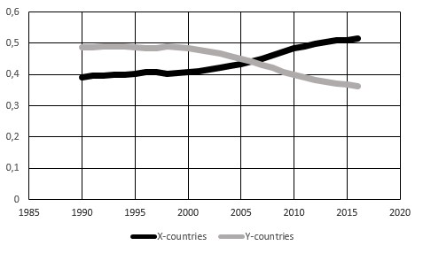
GDP of Non-Western X countries and Western Y countries, 1990-2017, as a share of the total world GDP, the World Bank database
(Test No 2, n=63).

Slide 27
Results
Comparison of the GDP produced by the two groups of countries made it possible to see the cyclical process of changing world leadership, i.e. in the prevailing dominance of countries with Western or Non-Western institutional models.
In the 1820s, Non-Western countries were leading in the production of world GDP.
Since the 1870's the domination of Western countries started, which began to produce more than half of the world GDP. The biggest gap between these two groups of countries was observed in the 1950s-1960s. Since the 1970s it began to decline.
In 2005-2008 Non-Western countries began outperforming Western countries by share of world GDP, and this advantage continues to gradually increase.

Slide 28
Summary and Conclusion

Slide 29
Summary
We compared the set of explicit and implicit premises on which orthodox and heterodox economists rely:
homo economicus versus embeddedness;
methodological individualism versus methodological holism (methodological institutionalism as well);
microfoundations versus the micro-meso-macro framework;
linear approach versus complexity (where not only decreasing but also increasing returns operate).

Slide 30
Conclusion-1
The competition of different scientific schools and approaches is quite natural for any science and contributes to the knowledge of the studied phenomena - in this case, the economy.
However, the controversy between orthodox and heterodox economists is not just about two competing research approaches relying upon different methodological principles and initial premises.
Behind this competition there are more fundamental factors due to the differing interests and ideological engagement of the two groups of economists.

Slide 31
Conclusion-2
HE has positive prospects both from the subjective and from the objective perspectives.
The subjective side is associated with the ever-increasing growth and quality of heterodox economic research.
The objective side is associated with an increase in the demand for heterodox research, including in connection with a change in the global alignment of economic power centres in the world.

Slide 32
Thank you for your attention!
Спасибо за внимание!
kirdina777@gmail.com

