Slide 1
Methodological individualism and methodological institutionalism
Svetlana Kirdina,
Institute of Economics,
Russian Academy of Sciences,
Moscow, Russia
Notes:
….

Slide 2
Outline
Methodological individualism as a core principle of mainstream economics.
Methodological holism in institutional studies
Institutional individualism as a middle way (Agassi, 1975; Toboso, 1995, 2001, 2008).
Methodological institutionalisms (Keizer, 2007; Kirdina, 2013) as a possible core principle of heterodox economics?

Slide 3
Methodological individualism as a core principle of mainstream economics.
Methodological individualism "assumes an explanation of the social and economic phenomena in terms of individual behavior" (Lukes, 1973, Hodgson, 2003, 2007).
Methodological individualism is a base of "neoclassical synthesis“ (Samuelson, 1967) and "new neoclassical synthesis“ (Woodford, 2009).

Slide 4
Methodological individualism and methodological holism
Methodological holism (Gruchy, 1947 ; Rutherford, 1989) usually is considered as an alternative to methodological individualism. Is it really fair?
The principle of methodological holism is the epistemological philosophical precondition which is being investigating since Aristotle (the IV century BC) and reflects an idea that "the whole is more than sum of its parts".
Its epistemological alternative is a reductionism (“the whole is understood as a set of primary elements forming it”)
A reductionism is expressed in economics as methodological individualism.
As for methodological holism, in economics it was still used “directly", without specification.

Slide 5
Institutional individualism as a middle way
Institutional individualism (Agassi, 1960, 1975; Jarvie, 1972; Toboso, 1995, 2001, 2008).
If we summarize views of institutional individualism supporters, we see that they are still focused on the analysis of human interactions in institutional environment where "macroeconomic effects have to be presented as a result of interaction of certain actors within existing institutions" (Polterovich, 2011)
I agree with Jarvie that institutional individualism is a more wide version of methodological individualism and it is still keeping "an explanation of the social and economic phenomena in terms of individual behavior".

Slide 6
Methodological institutionalism as holism in economics.
The integrity of economic systems is provided with structures of institutions. Therefore realization of holism in economics could be presented by methodological institutionalism.
Methodological institutionalism means an explanation of the social and economic phenomena in terms of functioning and change of institutional structure.

Slide 7
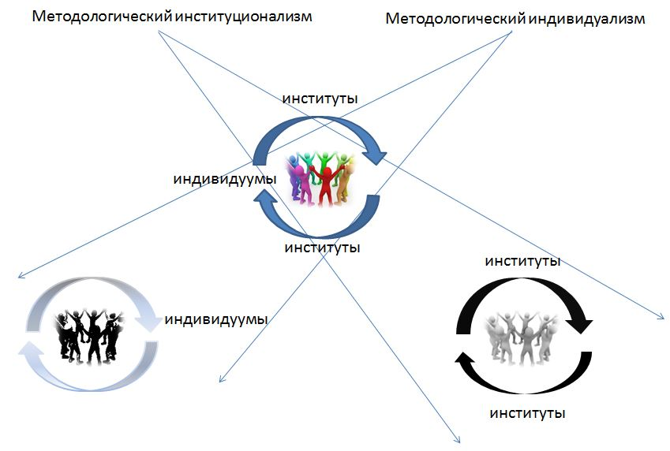

Slide 8
Metaphor of institutions
Metaphorically, institutions in society can be presented as power lines of an electromagnetic field. Interaction between the moving particles is carried out by means of a magnetic field.
Similarly, interactions of actors are carried out by institutions ("power institutional lines“).

Slide 9
Examples of methodological institutionalism
Eucken W. (1939). Die Grundlagen der Nationalökonomie. Jena: Gustav Fischer.
Eucken W. (1965). Grundsätze der Wirtschaftspolitik. Rowohlt: Reinbek.
Polanyi K. (1957). The Economy as Instituted Process. / The Sociology of Economic Life. Mark Granovetter and Richard Swedberg (eds.). Boulder, CO: Westview Press.
Kirdina S. (2013). New systemic institutional approach for comparative political and economic analysis. // Review of Radical Political Economy. September. Vol. 45. Number 3.

Slide 10
Methodological principles in the analysis of economic systems
development of an universal and ideologically neutral language to describe different economic systems;
definition of economic system as an institutional structure;
holistic approach focused on the economic system as a whole not on the economic agents’ behavior;
institutional approach and the construction of the underlying structure of institutions (the morphology in term by W. Eucken), forming the basement of economic systems;
comparative and typological analysis, based on the underlying structure of institutions;
hermeneutic methodology, which results in elaborating of “ordoliberal orders” (W. Eucken) or “modes of regulation” (according with Regulation theory) and understanding of the real-life economic systems as special cases of these orders or modes.
Notes:
Summarizing main authors of above mentioned research programs we can point to the following significant methodological principles in the analysis of economic systems:

Slide 11
Question as conclusion
Methodological institutionalisms (Keizer, 2007; Kirdina, 2013) could be a possible core principle of heterodox economics?

Slide 12
Thank you for your attention!
kirdina@bk.ru
www.kirdina.ru

