Slide 1
The Great Reset Project, Polycrisis and Reconfiguration of the Global World
37th EAEPE Annual Conference ,
September 24-26, 2025 , Athens, Greece
“The Janus face of AI. Opportunities and threats”
Svetlana Kirdina-Chandler,
Leading Researcher,
IE RAS, Moscow, Russia

Slide 2
Motivation
The polycrisis, with its interweaving of several crisis dynamics - environmental and climatic, pandemical, technological, migrational-demographic, social, cultural, and political -, is connected with the systemic complexity (overcomplexity) of modern societies.
I share one of the main thesis of our JAES this year session: a polycrisis is a manifestation of the impossibility of socio-economic systems, as currently structured, to cope with the interweaving of diverse challenges they currently face.
In what direction is the reconfiguration of the modern socio-economic systems taking place, and how successful are global technological projects in overcoming the consequences of a polycrisis?

Slide 3
The main hypothesis
The polycrisis is caused, among other things, by the fact that modern international institutions are inadequate to the reality of the highly complex modern world.
Such an inadequate mega-institution is unipolar globalization, in which the capitalist model is proposed (imposed?) on the world by the leaders of today’s (yesterday’s?) globalization, led by the US. One of the "mouthpieces" of these leaders is the World Economic Forum, with its various technological projects (the "Great Reset" project is one of them) to support a unipolar global world.
Despite these projects, the global unipolar world is crumbling. The consequence is not the fragmentation of the world, as is often discussed, but the emergence of a bipolar world.

Slide 4
Outline
General analysis of the “Big Projects” of the World Economic Forum.
The “Great Reset” project: problem of implementation in the changing world.
Unipolarity, multipolarity (fragmentation), or bipolarity?
Institutionalization of bipolarity.
Conclusion.

Slide 5
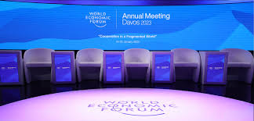
General analysis of the “Big Projects” of the World Economic Forum.

Slide 6

The “Great Reset” project amid other “Big Projects” of the WEF
The “Great Reset” project of the WEF launched in 2020 aims to restore the global economy and ensure sustainable development and “activate innovation, science and technology to achieve significant breakthroughs that will help make ideas of sustainability more profitable.”
It continues the logic of previous WEF projects and is aimed at improving the position of global capitalism, which is losing its world leadership.
The “Digital Revolution” was an example of such a “Big Project”.

Slide 7
The “Digital Revolution” project’s story
In 2009 the project of the “Digital Revolution”, announced as a reliable means of overcoming the global financial crisis of 2008-2009, was also presented as “the basis for the subsequent sustainable development of the world economy” (ICT for Economic Growth: A Dynamic Ecosystem Driving the Global Recovery, 2009).
Further consideration of it showed, however, that it contributed primarily to 1) the creation of new markets for international financial players in the telecommunications sector compensating for the previous drop in profits in this area in earlier years (Ganichev, Koshovets, 2020) and 2) the project has deepened global social inequality because of the "digital divide".

Slide 8
The “Digital Revolution” as an example of “Big Project”
Its definitions resulted from the fact that developed countries have already created ICT infrastructure, as well as their own digital platforms and hardware and software systems.
With the support of government agencies and consortiums of large national and transnational corporations, purposeful support is being provided for the spread of these technological innovations beyond the developed countries.
At the same time these innovations have become the subject of global financial and industrial property. The right to own them has been institutionalized in a system of international standardization.
Control over the system of standardization of such technologies actually allows developed countries (and the largest TNCs) to become monopolists in the field of ownership of the rights to the most important digital technologies.

Slide 9
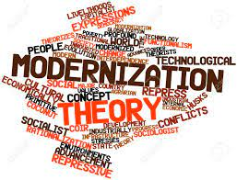
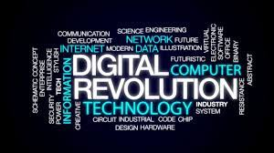
“Digital revolution” as a Modernization project
“Digital revolution” project has primarily an economic orientation; it is subordinated to the practical tasks of extracting maximum profit from the economic periphery.
Modernisation theory forms a scientific (and then ideological) basis for the “Digital revolution”.

Slide 10
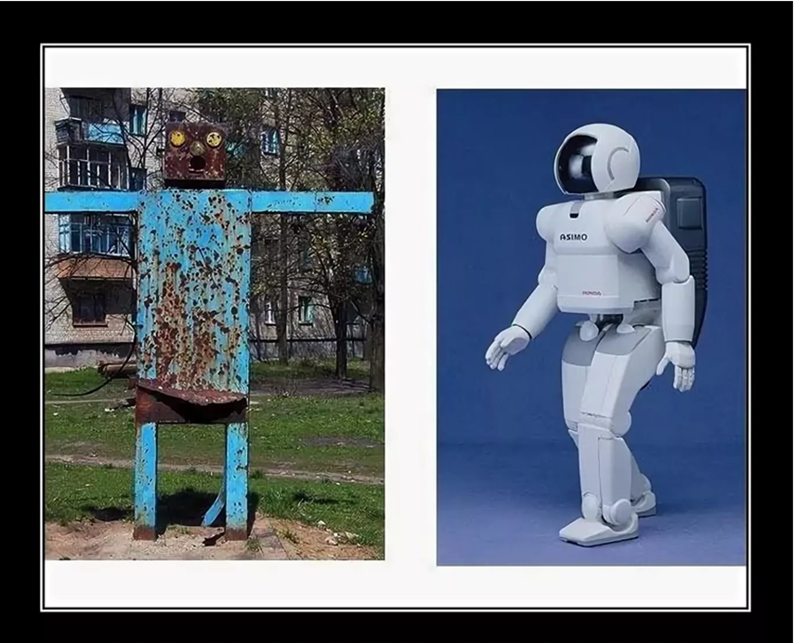
“Big Projects” of the WEF
Any project is a plan to create a new type of reality, i.e. something that did not exist before, but can now exist on its own. Each project has a goal and actors interested in it.
"Big Projects" of the WEF is the creation of new fields of activity, which gradually become independent, and in the long term, commercialized, i.e. attract new resources. This is the main goal.
The key feature of such projects is that in reality two different “projects” take place – one for developing countries and the other for developed countries.

Slide 11
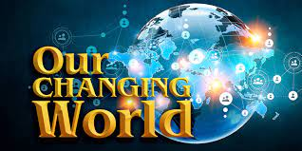
The “Great Reset” project: problem of implementation in the changing world.

Slide 12
The world is changing
The main problem with the implementation of the next big WEF project, namely the “Great Reset”, is that the unipolar world, which made it possible to implement such projects with a primary benefit for developed countries, is being destroyed.
There is a downward trend of globalization with the dominance of one player (the US), and the world is facing a choice of a new development model.
Models of a non-polar world or sovereign countries, a new unipolar world, multipolarity, and bipolarity are discussed.

Slide 13
A non-polar world: signs of sovereignty
1) The growth in the number of fences and walls between states. For the period 1945–1989 countries erected 19 walls between themselves. In 1991, this number was reduced to 12 (the era of the "fall of the Berlin Wall"). However, by 2014, there were already 64 walls (Borders, Fences and Walls, 2014: 2), and their number is steadily growing.
2) Invisible walls also grow (for example, “visa walls”).
The new walls protect countries not so much from military attacks, as it was before, but they mark the invisible borders of countries as different economic, political and cultural systems and prevent global “undesirable” flows of migrants, tourists, goods, services, etc.

Slide 14
A non-polar world: signs of sovereignty cont.
Localization of production and reshoring developed since 2010s, i.e. return of previously transferred production back to the country, to protect against global risks:
- the US: “Remaking America”, 2010 (B. Obama); "America first", 2016 (D. Trump); "Restoring domestic production capacity", 2021 (J. Biden): “MAGA”, 2024 (D. Trump);
- the United Kingdom: "Reshore UK“
- France: “Colbert 2.0”
- similar programmes in Japan, South Korea and other Asian countries (Mariotti, 2022)
- Russia: relocalization of production of critical goods, nationalization of technical standards, etc.

Slide 15
Model of a non-polar world of sovereign countries is not viable
“A non-polar world is a phenomenon known for its uncertainty, historically and geopolitically, and is extremely dangerous, when the struggle of all against all does not cease for a minute ... it is also dangerous due to the unpredictability of the consequences: what it will transform into and which model of the world order will win” (Danilov, 2017:68).

Slide 16
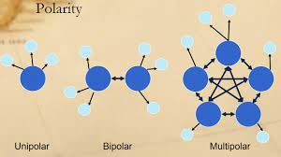
Unipolarity, multipolarity, or bipolarity?

Slide 17
Unipolarity
The unipolarity of the world means the hegemony of one global player. Such a world was envisioned by the supporters of the theory of globalization and Fukuyama’s former concept of the "end of history".
But in an interview on March 30, 2022, Fukuyama refuted himself and was forced to admit "the end of the end of history" in our time (Fukuyama, 2022).
History itself has pronounced a negative verdict on unipolarity. So realistic experts do not consider the "new unipolarity" as a possible model for overcoming the world chaos.

Slide 18
Multipolarity - pros
The statistical substantiation of a transition to a multipolar world comes from forecasts of the reconstruction of the world system of the largest economic centers, comparable to each other in terms of power, but civilizational and culturally different.
“So, it is expected that by 2030 the United States, in terms of real GDP, will give way to China, India will rise from 10th to 3rd place, and Brazil (by 2050) from 6th position will take 4th place. At the same time, over the same period, Japan will drop from 3rd to 5th place, Germany from 4th to 9th, France from 5th to 10th, and Italy and Britain will leave the top ten largest economies of the world. Russia in these calculations will rise from the 9th position to the 6th” <it is the 4th now – SK-C> (Miller, 2015:11).

Slide 19
Multipolarity - cons
The thesis of multipolarity (or “polycentricity”, “constructive polycentrism”, “world order of interacting local civilisations”, “multipolar constellation” etc.) as the most preferred model of a sustainable world has many supporters among experts, scientists, and politicians, especially outside the West.
In turn, the opponents of multipolarity identify it with chaos (Kissinger, 1997) and believe that a multipolar world is a transitional phase from a unipolar world to a bipolar one (Arin, 2001).

Slide 20
“Geoeconomic fragmentation” as a special case of multipolarity
.
There's much talk these days about the policy-driven process of “geoeconomic fragmentation” that's replacing globalization (IMF conference of Geoeconomic fragmentation, May 25, 2023).
This represents a special case of multipolarity and therefore is not a sustainable model for a new global reconfiguration.

Slide 21
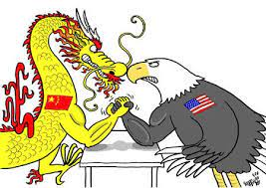
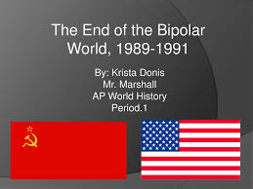
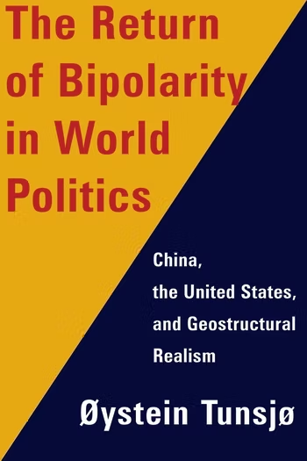
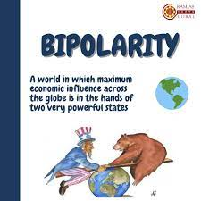
Bipolarity ≠ just a fight between giants

Slide 22
Bipolarity: our understanding
Bipolarity is inherent in the world organically: “ …at the global level, the world social system has always been and remains bipolar in the first approximation, ... therefore the world is simply doomed to be bipolar, because the poles must complement each other within the unity of opposites” (Tikhomirov, 1997: 54–55). Bipolarity ≠ “center-periphery model”.
Bipolarity provides a dynamically tense balance (the term “peaceful coexistence” was used during the Soviet era) and prevents conflicts, especially if it is institutionalized through the creation of equally powerful “symmetrical” coalitions.

Slide 23

Institutionalization of bipolarity.

Slide 24
Bipolar coalitions
In the XXI century, the institutionalization of bipolarity is expressed in the crystallization of two planetary coalitions, which can be conditionally called Western and non-Western.
The core of the Western coalition comprises NATO (founded in 1949) and the European Union (1993), with the composition of their member countries intersecting.
The core of the non-Western coalition are the structures of the SCO (founded in 2001, until 2001 - the "Shanghai Five"), BRICS+ (2006) and the CIS (Commonwealth of Independent States,1991), the composition of which is also increasingly overlapping.

Slide 25
The core of the Western Coalition, 2001-2024
Organizations | 2001 No. (countries) | 2024 No. (countries)
NATO | 19 | 32
European Union | 15 | 27
Total (including overlaps) | 24 | 36 1,5

Slide 26
The core of the Non-Western coalition, 2001-2024
Organizations | 2001 No. (countries) | 2024 No. (countries)
Shanghai Cooperation Organization (incl. Dialogue Partners) | 5 | 27
BRICS+ (incl. Partner Countries) | 4 | 18
Commonwealth of Independent States | 10 | 9
Total (including overlaps) | 13 | 40 3,0

Slide 27

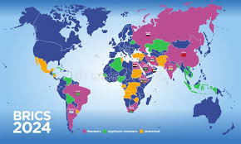
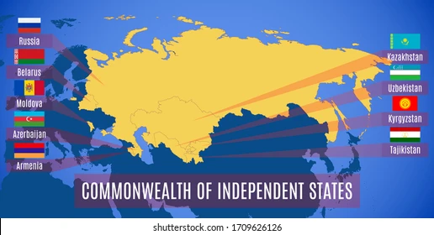
Geography of the BRIC+, SCO, and CIS countries

Slide 28
X- and Y-coalitions
In terms of the theory of institutional X-and Y-matrices (Kirdina, 2014; Kirdina-Chandler, 2017), we can call the non-Western and Western coalitions as X- and Y- coalitions respectively, because they are formed by countries dominated by institutions of either the X- or Y- matrix.
The Y-coalition, which began to institutionalize 40 years earlier than the X-coalition, includes 36 countries.
The X-coalition includes 40 countries: over the past twenty years it has tripled in size (and the process is continuing), while the Y-coalition has increased by one and a half times.

Slide 29
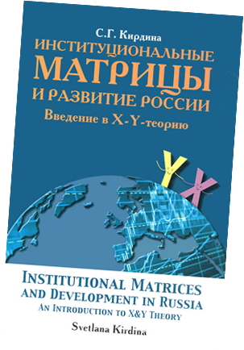
The trend of institutionalization of bipolar X- and Y-coalitions was noted back in 2014:
“… bipolarity finds its expression not only in the concentration of material and technological potential in each of the groups of countries, but also in the strengthening and development of institutional structures and ties. Ultimately, it is they who become the milestones of the so-called “new world order”... At one pole of this order, Western countries are concentrated with the dominance of Y-matrix institutions. They are increasingly strengthening cooperation with each other... At the other extreme, which includes groups of countries dominated by the X-matrix, there are parallel processes” (Kirdina, 2014: 315-316. In Russ.).

Slide 30
Strengthening cooperation among X-сoalition countries
Institutional cooperation: The commonality of the agenda of the X-coalition countries was recorded in 2020, when for the first time the SCO+ format was tested in an international forum, in which the SCO, CIS and BRICS countries participated together. This process continues: e.g. on September 16, 2022 in Samarkand (Uzbekistan) a meeting of the "SCO on an expanded scale" was held etc.
Economic cooperation: The growth rate of mutual trade is outpacing the growth rate of GDP for these countries.
A joint depository of the BRICS+ countries is being created to ensure independence from global financial (Western) markets).

Slide 31

Strengthening cooperation among X-сoalition countries cont.
Political cooperation: these countries are increasingly demonstrating solidarity in their votes when discussing various issues at the UN.
Cultural cooperation: On September 23, 2025 the first international song contest Intervision took place in Moscow, Russia. Each of the 23 participating countries submitted songs in their official languages. Next contest (2026) will take place in Saudi Arabia.

Slide 32

Value differences between X- and Y-coalitions
Vienna World Convention 1993: the universal nature of human rights and freedoms is beyond doubt (Y-coalition countries).
Bangkok Declaration of Asian States, 1993: the need to consider human rights in national and regional contexts, the principle of respect for national sovereignty and non-interference in internal affairs (X-coalition countries).

Slide 33



2022 FIFA World Cup, Qatar

Slide 34

Conclusion

Slide 35

Positive forecast for reconfiguration of the global world
The institutionalization of bipolarity in the XXI century will not mean a return to the discourse of the Cold War and the confrontation between the two poles of power, permeated with the “friend-enemy” dichotomy (Schmitt, 2007 (1932)), but will support a dialogue between large equivalent subjects of world economy and politics.
It will help to manage polycrisis and contribute to maintaining collective security.

Slide 36
References
Arin O. A. [Aliev R. Sh.] 2001. Twenty-first Century: The World without Russia. Moscow: Alliance. (In Russ.)
Bauman Z. 2005. 44 Letters from the Liquid Modern World. Cambridge: Polity.
Borders, Fences and Walls. State of Insecurity? / Ed. by E. Vallet. 2014. NY: Ashgate.
Danilov A.N. 2017. Global chaos in a non-polar world: on the way to a new world order. In: Global World: Systemic Shifts, Challenges, and Shapes of the Future. St. Petersburg: 68-71. (In Russ.)
Calhoun, 2006. Theories of Modernization and Globalization: Who Invented Them and Why.
Institute for Social Design (INOP), March 20, 2006. (In Russ.)
Fukuyama F. 2022. Interview, March 30, 2022. (https://www.newstatesman.com/encounter/2022/03/francis-fukuyama-on-the-end-of-the-end-of-history).
Ganichev N.A., Koshovets O.B. 2020. How to calculate the digital economy: between reality and design // ECO, 2(548): 8–36 (In Russ.)
ICT for Economic Growth: A Dynamic Ecosystem Driving the Global Recovery. 2009. Davos: World Economic Forum Annual Meeting Report.
Kirdina S.G. 2014. Institutional Matrices and Development of Russia. Introduction to X-Y-theory. 3rd ed. Moscow- St. Petersburg: Nestor-History. (In Russ.)
Kirdina-Chandler S.G. 2017. Institutional matrices theory, or X- and Y-Theory: A response to F. Gregory Hayden. Journal of Economic Issues. No. 51(2): 476-485.
Kissinger G. 1997. Diplomacy. Moscow: Ladomir. (In Russ.)
Miller D. T. 2015. Defence 2045. A Report for the CSIS International Security Program. Lanham, Boulder, New York, London: CSIS.
Schmitt C. 2007 [1932]. The Concept of the Political. Chicago, London: The University of Chicago Press.
Tikhomirov V.B. 1997. “Global matrimony”: reasonable unity of opposites in the world system of states // POLIS [Political Studies]. No. 2: 53-55. (In Russ.)

Slide 37
Thank you for your attention!
Svetlana KIRDINA-CHANDLER
kirdina@inecon.ru
kirdina777@gmail.com
www.kirdina.ru

