Slide 1
Probing Deeper Inside of Evolution:
Competition and Struggle Versus Cooperation and Mutual Aid
Svetlana Kirdina
Institute of Economics, Russian Academy of Sciences, Moscow, Russia
John Hall
Portland State University, Portland, Oregon, USA

Slide 2
Outline
Introduction: Ongoing Debates.
Chapter 3 “Struggle for Existence” of The Origin of Species by Charles Darwin: Thomas Robert Malthus influence.
Contributions by Russian scholars, including Peter Kropotkin, focused on cooperation and “mutual aid” in natural selection and evolution.
Conclusion: Thorstein Veblen and Peter Kropotkin about social evolution.

Slide 3
1. Introduction:
Ongoing Debates
(Competition and Struggle versus
Cooperation and Mutual Aid)

Slide 4
Reviving a debate in the Russian social science of the period 1860 and early decades of the 20th century for the Original Institutional Economics (OIE)
Does competition and struggle serve as the main variables initiating and driving natural selection and evolution? Or is cooperation and mutual aid the driver? These questions remain fundamental for those seeking to advance what is recognized as the tradition OIE.

Slide 5
2. Chapter 3
“Struggle for Existence” of The Origin of Species by Charles Darwin:
Thomas Robert Malthus influence

Slide 6
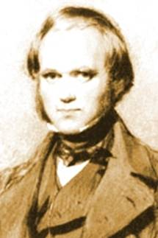
Charles Darwin (1809-1882)
The Origin of Species by Means of Natural Selection. London: John Murray [1859].
The Descent of Man, and Selection in Relation to Sex. London: John Murray [1871].

Slide 7
Around Darwinian ideas
On the one hand, Darwin was influenced by Britain’s intellectual and cultural environment into which he hypothesized and theorized (what Michel Foucault introduces by a term “episteme”). T.R. Malthus ideas (see An Essay on the Principle of Population, 1798) were especially meaningful and integrated into Origins as Chapter Three “Struggle for Existence.”
On the other hand, after Darwin the evolution as a subject of theorizing registers as “… one of the most ideological of sciences” (Kolchinsky, 2015:4).

Slide 8
Origins [1859] Chapter 3, “Struggle for Existence.” Gramercy Book, N.Y., 1979, p. 117:
… as more individuals are produced than can possibly survive, there must in every case be a struggle for existence,
… either one individual with another of the same species, or with individuals of distinct species, or with physical conditions of life.
… It is the doctrine of Malthus applied with mainfold force to the whole animal and vegetable kingdom; ….

Slide 9
3. Contributions by Russian scholars focused on cooperation and “mutual aid” in natural selection and evolution

Slide 10
Darwin’s The Origin of Species (1859) in Russia
In 1861 the journal Library for Reading published an essay on The Origin of Species that was more systematic and more comprehensive than any previous study on the subject published in Russian.
In 1863 the first number of the Russian Herald Sergei A. Rachinsky - professor of botany at Moscow University -explained every major component of Darwin's theoretical structure in a language that was accessible to the general reading public. He identified The Origin of Species as "one of the most brilliant books ever to be written in the natural sciences.“
In 1864 Rachinsky produced the first full Russian translation of the Origin.

Slide 11
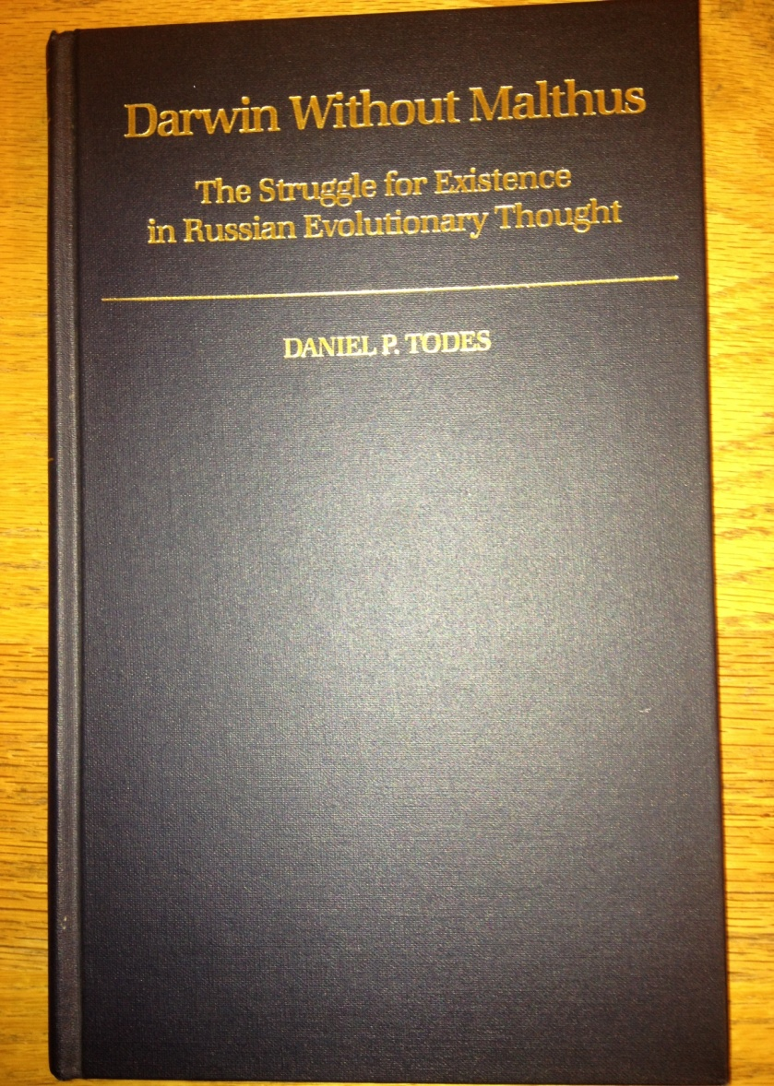

Daniel P. Todes, 1989 & Alexander Vucinich, 1989
.
Notes:
We are not the firsts who investigate the Darwinian ideas in Russia. But it is the first time to comprehend his ideas in the context of traditional institutional school and try to integrate his intellectual contribution into the modern institutional theory.

Slide 12
Acknowledging Darwin’s Contributions in Russia
“Darwinism changed not only our commonsense and scientific ideas but also our world view" (Danilevsky, Darvinizm, vol. 1, part 1: p. 7. In Russian).
Vucinich (1989: 31) stresses that in these decades near the end of the 19th century, many Russian scholars “… made Darwin’s theory the point of departure in wide areas of scientific research.”

Slide 13
Criticism of applicability of the biological principles of evolution like the “struggle for existence”
The general reaction that we can also note is for representatives of different political groups and ideological wings to focus on Darwin’s Malthusian influences. Competition and struggle for existence were a main focus on criticism. Among the critics were groups known as Slavophiles, Liberals, Populists, and Anarchists (see our paper in detail).

Slide 14
Peter Kropotkin who offered the most constructive criticism of Darwin’s reliance of Malthus’ notion of struggle for existence
Well-known theorist of Anarchism Prince Peter Kropotkin (1842-1921) displayed a profound respect for Darwin’s thinking and regarded the theory of natural selection as “… perhaps the most brilliant scientific generalization of the [19th] century” (Avrich, 1988:58).
In addition, Kropotkin accepted that the struggle for existence played an important role in the evolution of species and went further and argued that life is a struggle; and in this struggle the fittest survive.

Slide 15
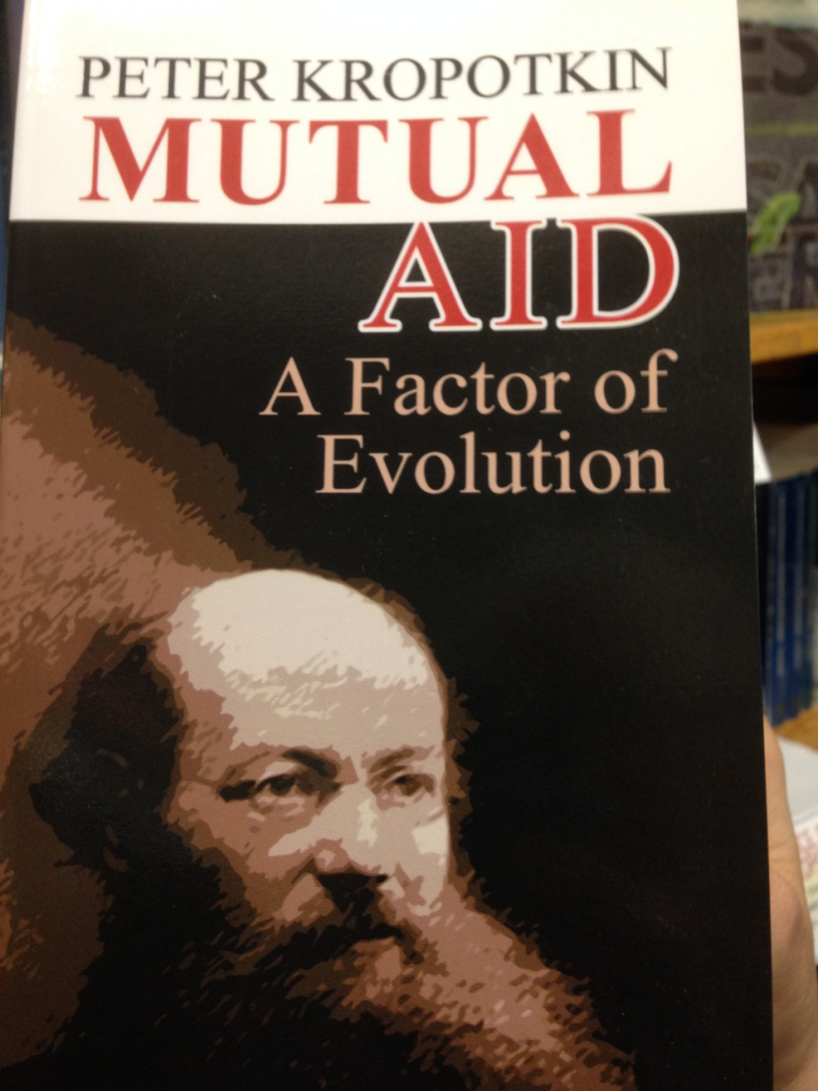
However, in his foundational book Mutual Aid: A Factor of Evolution [1902] (2006), Kropotkin criticized Darwin’s emphasizing competition and the struggle for existence as a valid and universal law. In its place, he introduced the Law of Mutual Aid.

Slide 16
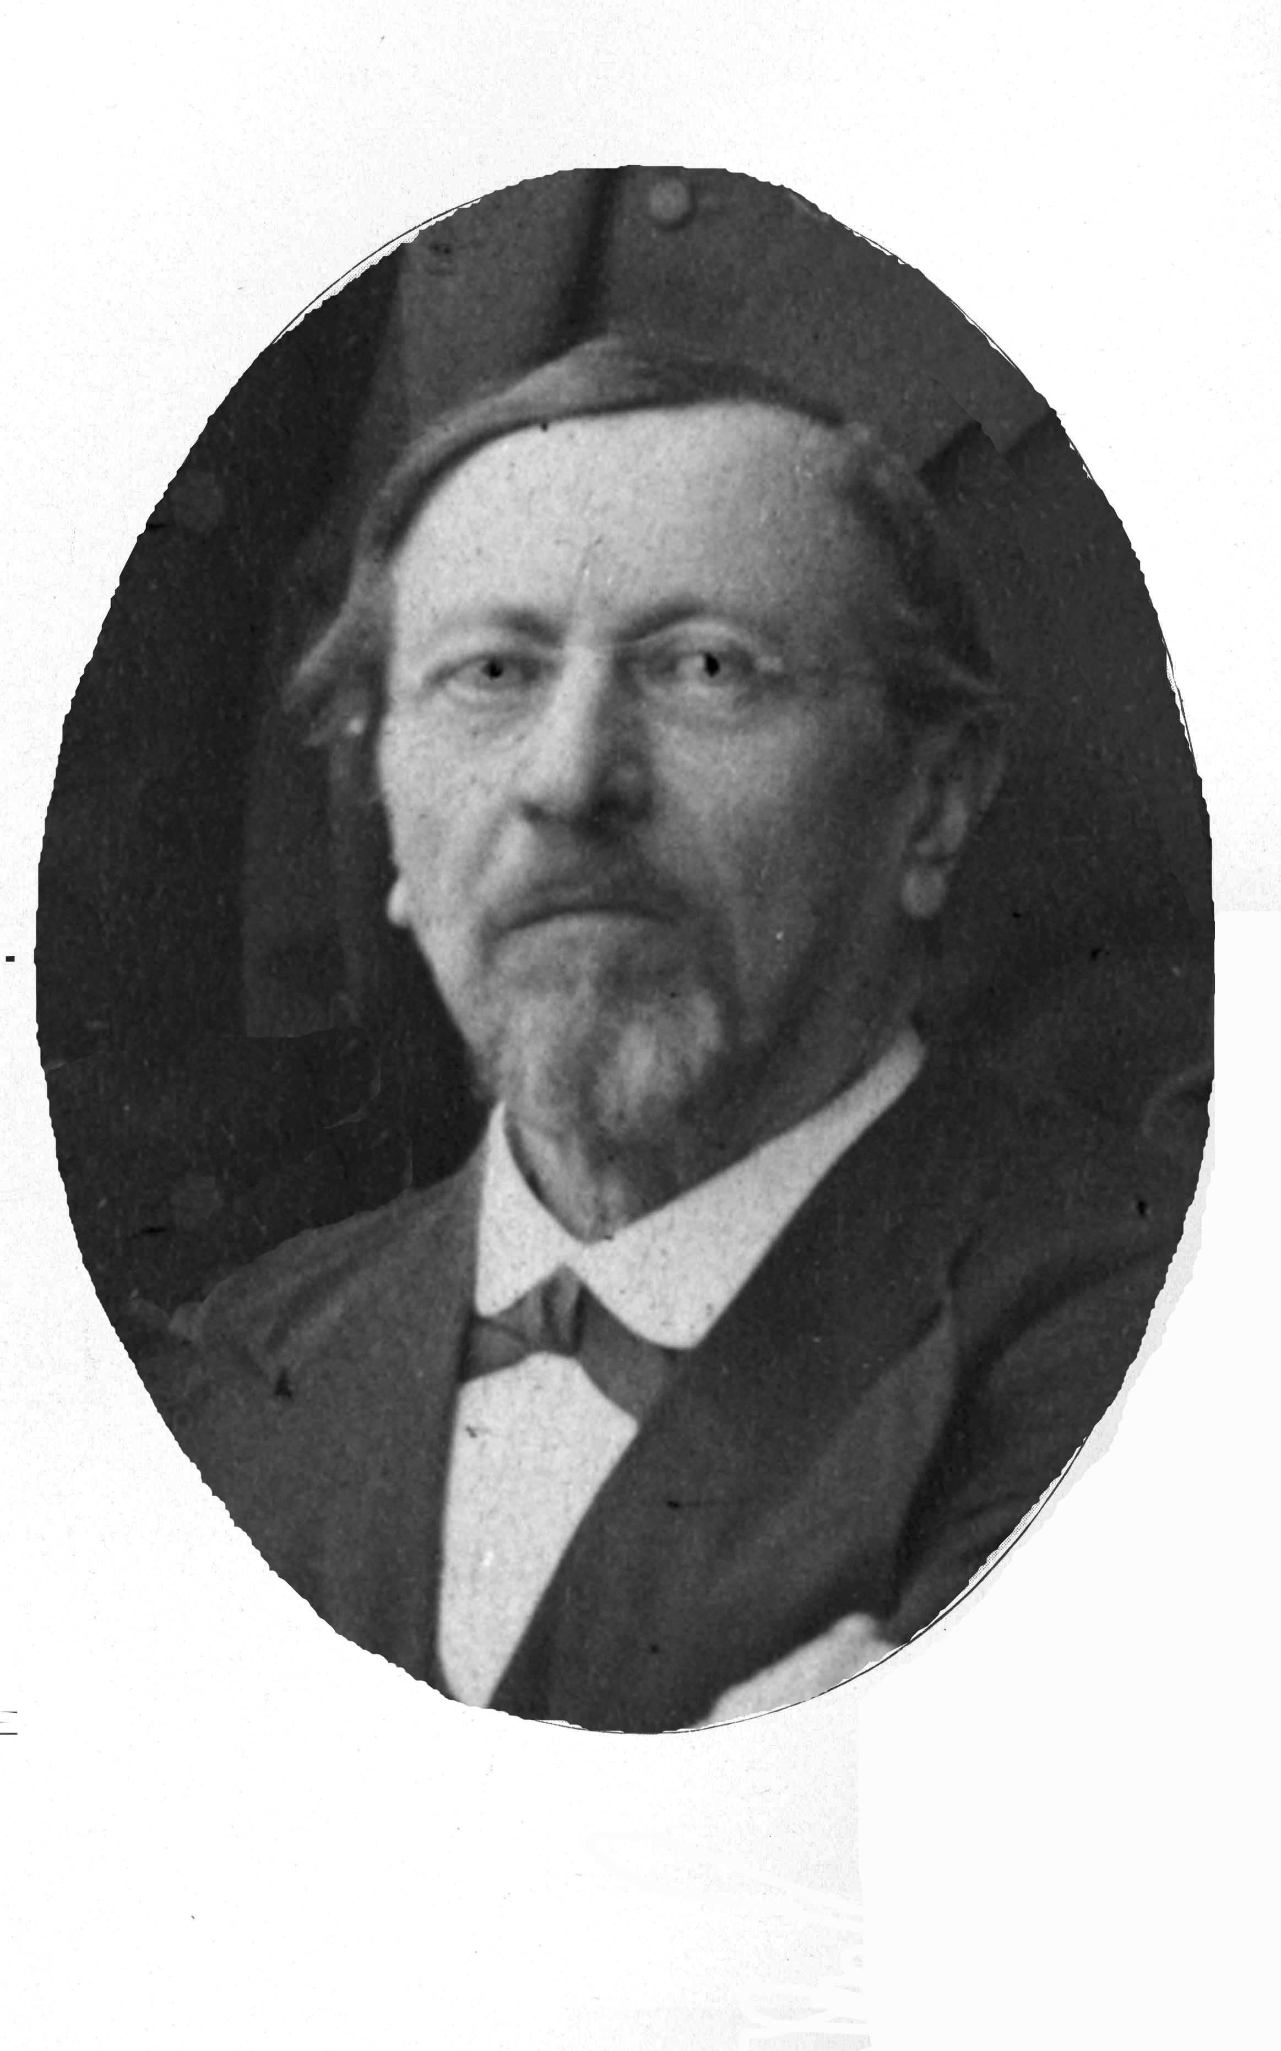
Kropotkin was influenced by ideas of Russian zoologist Karl Kessler (1815-1881) who introduced the Law of Mutual Aid in 1880.

Slide 17
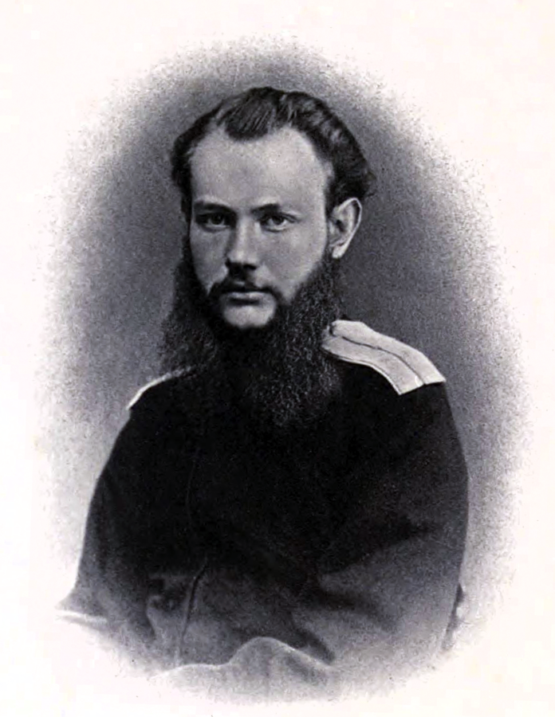
Empirical Beginnings of Kropotkin’s views
In 1864-65 Kropotkin initially served as attaché to the governor-general of East Siberia. That times he accepted charge of several geographical survey expeditions in Siberia.

Slide 18
Kropotkin after his travels to Northern Asia
“ I conceived since then serious doubts -- which subsequent study has only confirmed -- as to the reality of that fearful competition for food and life within each species, which was an article of faith with most Darwinists, and, consequently, as to the dominant part which this sort of competition was supposed to play in the evolution of new species.” (Kropotkin, 1902).

Slide 19
Kropotkin after his travel to Northern Asia cont.
“I saw Mutual Aid and Mutual Support carried on to an extent which made me suspect in it a feature of the greatest importance for the maintenance of life, the preservation of each species, and its further evolution.” (Kropotkin, 1902).

Slide 20
Mutual Aid and Evolution
Kropotkin supposed that mutual aid would be considered, not only as an argument in favor of a pre-human origin of moral instincts, but also as a Law of Nature and as a factor in social evolution: ” [t]he animal species, in which individual struggle has been reduced to its narrowest limits, and the practice of mutual aid has attained the greatest development, are invariably the most numerous, the most prosperous, and the most open to further progress.” (Kropotkin, 2006:244).
It is Kropotkin’s view that when considering ethical progress, that indeed mutual aid not mutual struggle plays the leading role. Kropotkin (2006: 247) singles out mutual aid as the variable that would lead our societies to a “loftier evolution.”

Slide 21
Evolutionary Game Theory (EGT) about Cooperative Strategies: Latest Results
Based on the competition and individualism principles, so called Zero-determinant strategy was presented in EGT in 2012 as an extremely selfish, versatile, universal, and most effective strategy for the behavior of individuals ( Press, W. & Dyson, F. J. Iterated prisoners’ dilemma contains strategies that dominate any evolutionary opponent. // Proceedings of the National Academy of Sciences of the U.S.A, 2012. # 109. P. 10409–10413; Stewart, A. J. & Plotkin, J. B. Extortion and cooperation in the prisoner’s dilemma. // Proceedings of the National Academy of Sciences of the U.S.A. 2012. # 109. P. 10134–10135.)

Slide 22
Mutual Aid versus Individualism and Struggle for Existence
“The struggles between mutual aid and individualism make, in fact, the substance of history. We may thus take the knowledge of the individual factor in human history as granted…; while, on the other side, the mutual-aid factor has been hitherto totally lost sight of; it was simply denied, or even scoffed at, by the writers of the present and past generation. It was therefore necessary to show, first of all, the immense part which this factor plays in the evolution of both the animal world and human societies. Only after this has been fully recognized will it be possible to proceed to a comparison between the two factors” (Kropotkin, 1902).

Slide 23
Evolutionary Game Theory (EGT) about Cooperative Strategies: Latest Results cont.
However, later it was shown that Zero-determinant strategies are at most weakly dominant, are not evolutionarily stable, and will instead evolve into less coercive strategies. Such strategies allow players to recognize each other can be evolutionarily stable (and able to exploit other players). However, such an advantage is bound to be short-lived as opposing cooperative strategies evolve to counteract the recognition. (Adami С., Hintze A. Evolutionary instability of Zero Determinant strategies demonstrates that winning isn’t everything. // Nature Communications. № 4. 2013).

Slide 24
4. Conclusion:
Thorstein Veblen and Peter Kropotkin about social evolution

Slide 25
Veblen and cooperation ideas
Clearly Veblen, like Kropotkin, expressed a deep-seated appreciation for cooperation over competition, and this is expressed when he considers some of the problems arising in the capitalistic system. Veblen’s The Theory of Business Enterprise [1904] stresses a wide array of problems arising when businessmen, and their interests in pursuing profits, dominate over the engineers’ interests in producing efficiently at capacity, and the laborers imbued with workman instincts seek to apply their abilities for producing quality products.

Slide 26
Cooperation and social evolution
The thrust of Veblen’s contributions conform with Kropotkin’s, stressing that indeed cooperation proves more conducive to a favorable social evolution than does competition.

Slide 27
Thank you for your attention!
kirdina777@gmail.com
johnbattailehall@gmail.com

