Slide 1
Polanyi’s double movement in the modern market reforms of Russia and China
Svetlana Kirdina-Chandler
Institute of Economics, Russian Academy of Sciences,
Moscow, Russia

Slide 2

Motivation
After the crisis of 2007/8 the “Death of the Globalisation (neoliberal) Consensus” was recognised (Rodrik, 2008).
Processes “to tame the market economy” started to become apparent (“double movement” in the Polanyian sense).
In Russia and China disappointment in the "golden tablet of the market" had begun earlier in the 2000s and amplified after the crisis. It provoked the "double movement" towards returning the market to social and government control.
What are the specifics of this process in those parts of the world?

Slide 3
Outline
Theoretical frameworks of the analysis: the theory of X-and Y-institutional matrices.
Comparative analysis of Russian and Chinese transitional reforms.
Increasing social inequality as a major challenge and driver of a double movement with its protective response.
Hypothesis about the features of the double movement in Russia and China compared to Western countries observed by Polanyi.
Conclusion and discussion.
Notes:
It motivated me to prepare the paper with the following structure:

Slide 4
the theory of X- and Y- institutional matrices
Theoretical frameworks:

Slide 5
Some bibliography
2000, 2001, 2014. Kirdina S.G. Institutional Matrices and Development in Russia. 3 editions. (In Russian).
2010. Institutional Matrix Theory. Sociological dictionary. (In Russian).
2014. Kirdina, Svetlana. “Institutions and the Importance of Social Control in a Nation’s Development.” Journal of Economic Issues. 47, 3.
2017. Kirdina-Chandler, S. ”Institutional Matrices Theory, or X-and Y-theory: A Response to F. Gregory Hayden”. Journal of Economic Issues. 51, 2.
more on the web-site www.kirdina.ru

Slide 6
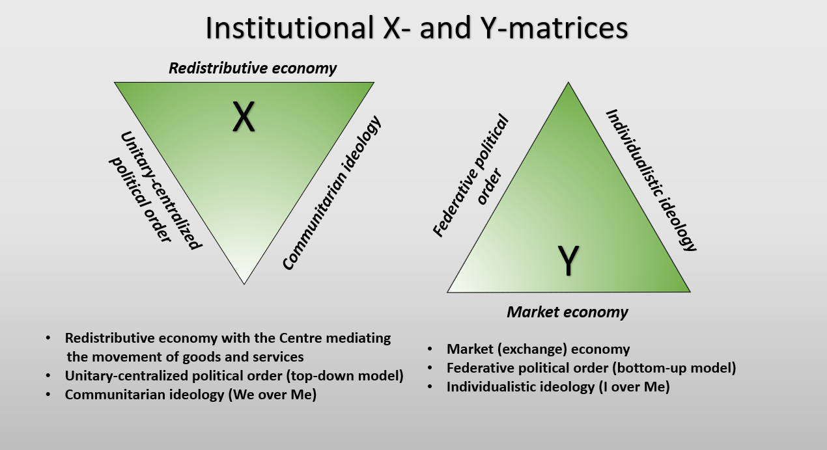

Slide 7
Complementarity of institutional matrices
Y
Y
X
X
Russia, China, India, Europe and the US,
most Asian, Middle Eastern, Сanada, Australia,
Latin American and others and New Zealand
Notes:
Our hypothesis is that the institutional structure of each society can be presented as a combination of these two basic institutional matrices. In some societies the X-matrix institutions prevail, while Y-institutions help them. We assume that it is true for Russia, China, India and most Asian, Latin American, and some other countries.
At the same time in other societies the Y-matrix institutions predominates, whereas the X-matrix institutions are complementary and additional, as, for example, in most countries of Europe and western offshoots including the USA.
We suppose that the main task of social and economic policy in each country is to support the optimal combination of predominant and complementary institutions. For example, the economic policy has to find the best proportion between market and redistributive institutions as well as forms of their modernization.

Slide 8
RUSSIAN AND CHINESE TRANSITIONAL REFORMS
Comparative analysis:

Slide 9

Some bibliography
Åslund, 1995; Liu at al, 1998; Kotz, 2001; Polterovich, 2006; Kennedy, Omelicheva, 2010; Lin, 2012; Chzhao, 2013; Kim, 2015; Abasov, 2017; Družić, Mustać, 2017; Novokmet at al, 2018; Garnaut, Song, Fang, 2018; Hu, 2018…
https://www.google.ru/search?q=%D1%81%D0%BB%D0%BE%D0%B6%D0%BD%D0%BE%D1%81%D1%82%D1%8C&newwindow=1&source=lnms&tbm=isch&sa=X&ved=0ahUKEwit8PzyuN_YAhXKMywKHRKICVkQ_AUICigB&biw=1270&bih=564#imgrc=A8qFNHepA2DzNM

Slide 10
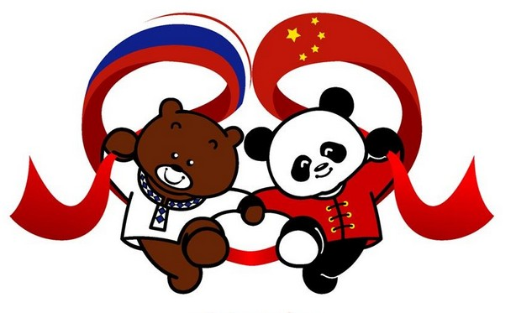
Transition from what?
These countries are called “communist” in English-language literature. However, neither the USSR nor China have ever called themselves as such.
They positioned themselves as socialist countries.
(Modern China continues to call itself a socialist country, and describes its social system as "socialism with Chinese characteristics“).

Slide 11
Transition to what?
State capitalism (as defined by Chomsky and others)?
Market societies?
More state control of the economy generally?
Hybrid regimes?
…

Slide 12
Market transition from Soviet-type Socialism in Russia and China
 | Russia | China
Started | 1991 | 1978
Approaches used | Shock therapy (privatisation and price liberalisation) | Gradualist (dual-track system with state planning)
Political component | Multiparty system - very weak before the 2000s, then an increasing role of the political centre | Leading role of the Communist Party of China and strong role of the political centre
Results to nowadays | From № 5 to № 6 economy of the world (GDP PPP) | From № 10 to № 2 (1?) economy of the world (GDP PPP)

Slide 13
MAIN CHALLENGE AND DRIVER OF A DOUBLE MOVEMENT
WITH PROTECTIVE RESPONSE
Increasing social inequality:

Slide 14
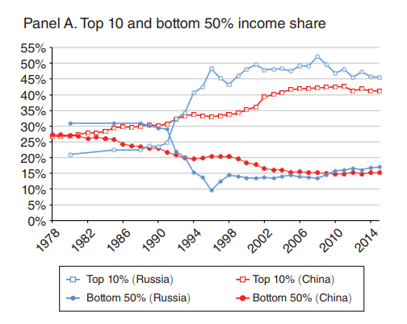
Distribution of Income in Russia and China

Slide 15
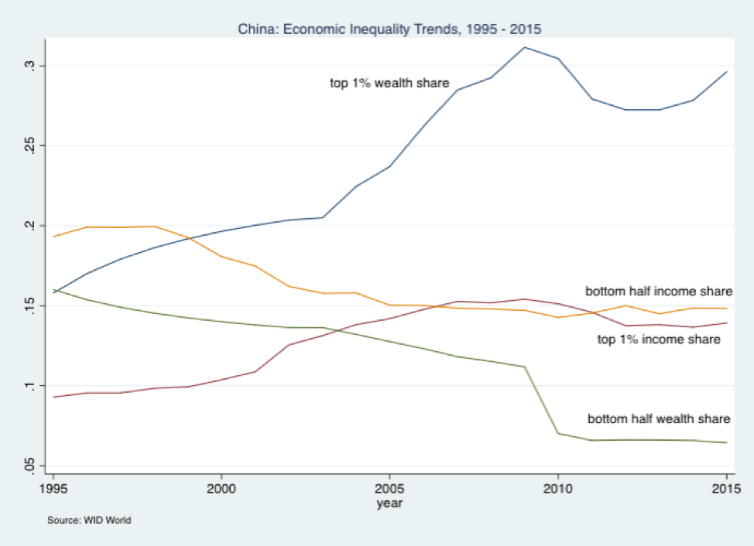
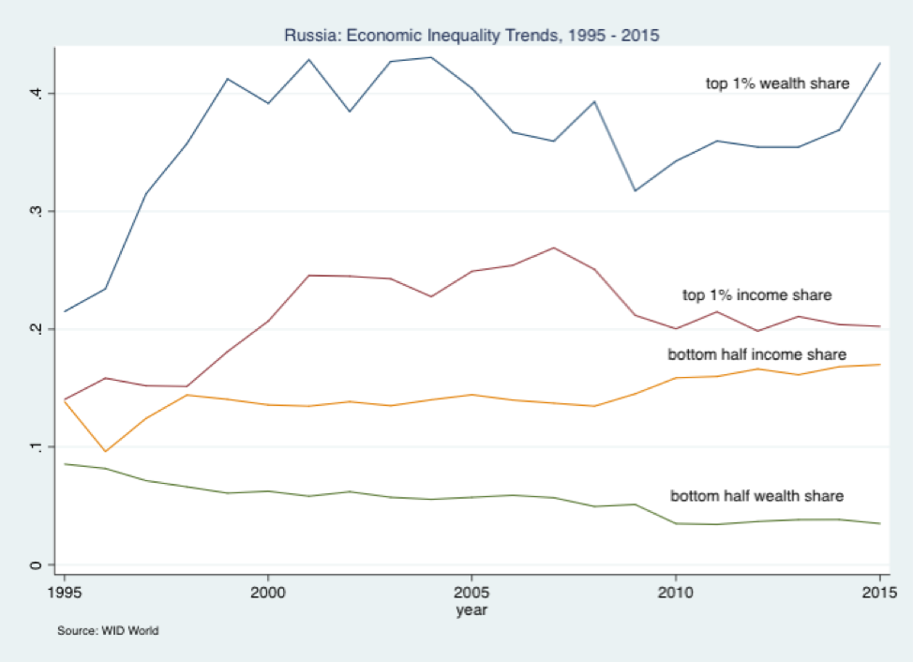
Income and Wealth Inequality in China and Russia (Source: Remington, 2018)

Slide 16
Increasing inequality
Economic inequality in wealth and household incomes is also accompanied by a growing regional and sectoral inequality in Russia and China.

Slide 17
of the double movement in X- and Y-countries
Hypothesis about the features

Slide 18
Main hypothesis
Within the framework of the X- and Y-institutional matrices theory the self-protection mechanism of societies to prevent increasing dominance of a market economy depends on what institutional matrix - X or Y, - prevails in an institutional structure.

Slide 20
Main hypothesis cont.
Disembeddment of the economy means that society activates other spheres - political and ideological - to tame the economy. So the predominant political and ideological institutions strengthen during the double-movement periods to hold back the economy.

Slide 21
Y-countries: Ideology Excessive Response
For Y-countries (or western countries, which were the main focus of Polanyi’s double movement analysis) these were institutions of federative political order and individualistic ideology with its priority of "I" over "We". Compared to periods of balanced development, the amplification of these institutions may be excessive.
This was the situation with the spread of fascist ideology as an “extreme pole” of individualistic values which Polanyi described in his “The Great Transformation”. Some observers notice the strength of fascist ideology in some modern European countries today.

Slide 22

X-countries: Ideology Excessive Response
For X-countries, namely China and Russia, which were not covered in Polanyi’s analysis, institutions of communitarian (collectivist) ideology with its priority of “We” over “I” start to strengthen a lot.

Slide 23
Ideology Excessive Response: some evidence
At the beginning and over the course of a number of years of ongoing reforms in China and Russia much attention was paid to promoting liberal values ​​of freedom and individual responsibility of citizens.
Now official rhetoric is characterised by a growing attention to the social responsibility of the state. This is reflected in the growth of social expenditures of state budgets and the adoption of a large number of social programmes that equalize access to economic opportunities.

Slide 24
Ideology Excessive Response: more evidence
New Year Address to the Nation” by President Putin on the eve of 2019: “We face many pressing tasks in the economy, research, technology, healthcare, education and culture. What matters the most is that we make steady progress in improving the wellbeing and quality of life in Russia… We will succeed, but only if we are able to work together. We never had any help in these endeavours, and never will. For this reason, we must form a team that is united, strong and acts as a single whole. Let the friendship and good hopes that bring all of us together accompany us moving forward and help us in our work and in achieving our common goals” http://en.kremlin.ru/events/president/news/59629).
There are similar ideas in Xi Jinping’s Thought on Socialism with Chinese Characteristics for a New Era - the latest theoretical innovation from the Communist Party of China, which guides the Chinese people in realising national goals together.

Slide 25
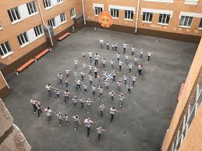
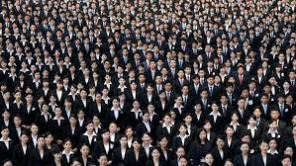
Social Immunity to ‘super-collectivism’

Slide 26
X-countries: Political Excessive Response
The role of the predominant political institutions such as the institutions of a unitary-centralised political order in Russia and China strengthen.
The concentration of the political leaders’ power in vertical hierarchical structures both in Russia and China takes place.

Slide 27
Features of Political Power Concentration
There are parallels between the political situations around Chinese president Xi Jinping and Russian president Vladimir Putin. A proposal of Mr. Xi to abolish the constitutional limitation of two terms for the head of the Chinese state is seen as evidence that he wants to abandon the convention of restricting the party leader to two five-year terms and continue to stay in office.
Similarly, Russian President Putin has already reached a milestone where he finds himself to have been in power (by the popular vote) more than other Soviet post-war leaders - before him such a leader was Leonid Brezhnev (Remington, 2018).

Slide 28
Conclusion and discussion

Slide 29
The main features of double movement in different countries were investigated within the framework of the X- and Y-institutional matrices theory. It showed that the self-protection mechanism of societies to prevent the increasing dominance of a market economy depends on what institutional matrix prevails in an institutional structure.
For China and Russia, where X-matrix institutions dominate, such mechanisms express themselves as an amplification of institutions of unitary-centralised political order and the strength of communitarian (collectivist) values at all levels of society (from micro to macro).
Protective responses in different types of societies make them more integrated and stronger after the turbulent periods of double movement.
Now we can see the reconstruction of a bipolar world. It is also associated with the dynamics of organisational forms reflecting the depth of the interconnections inside each of the poles of the global bipolar world. A strengthening of the bipolarity of the world will help to reduce chaos and improve the stability of international relations.

Slide 30
Thank you for your attention!
Спасибо за внимание!
kirdina777@gmail.com

